Slide 1
WELCOME! Happy to see u again ☺
Europe Regional Office
FAEEN meeting
30 September 2021

Slide 2
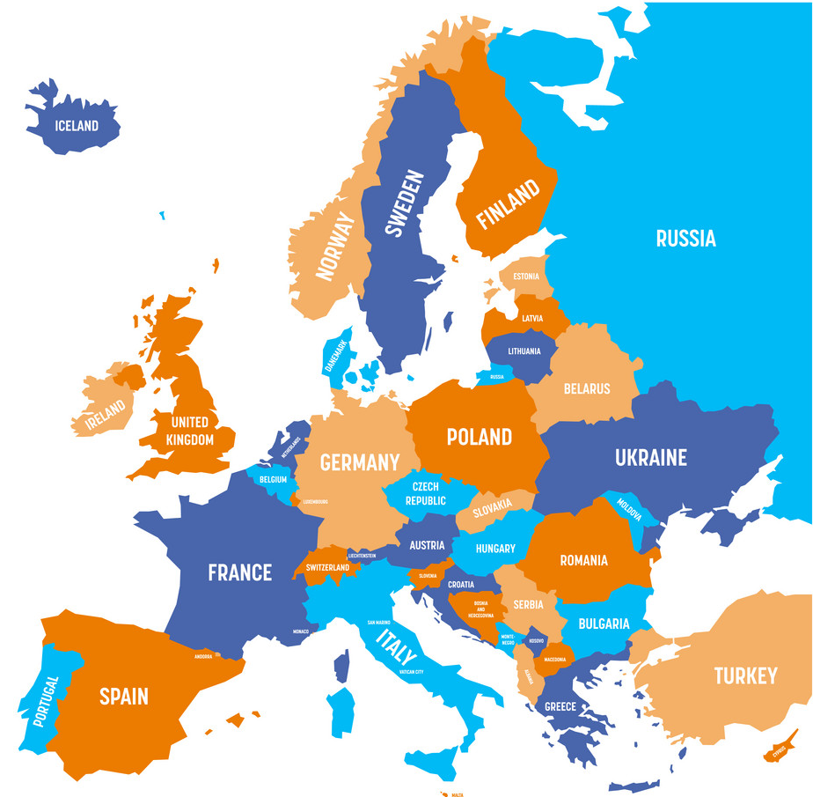
Global First Aid Reference Centre hosted by the FRC - Paris
IFRC Regional Office Europe - Budapest

Slide 3
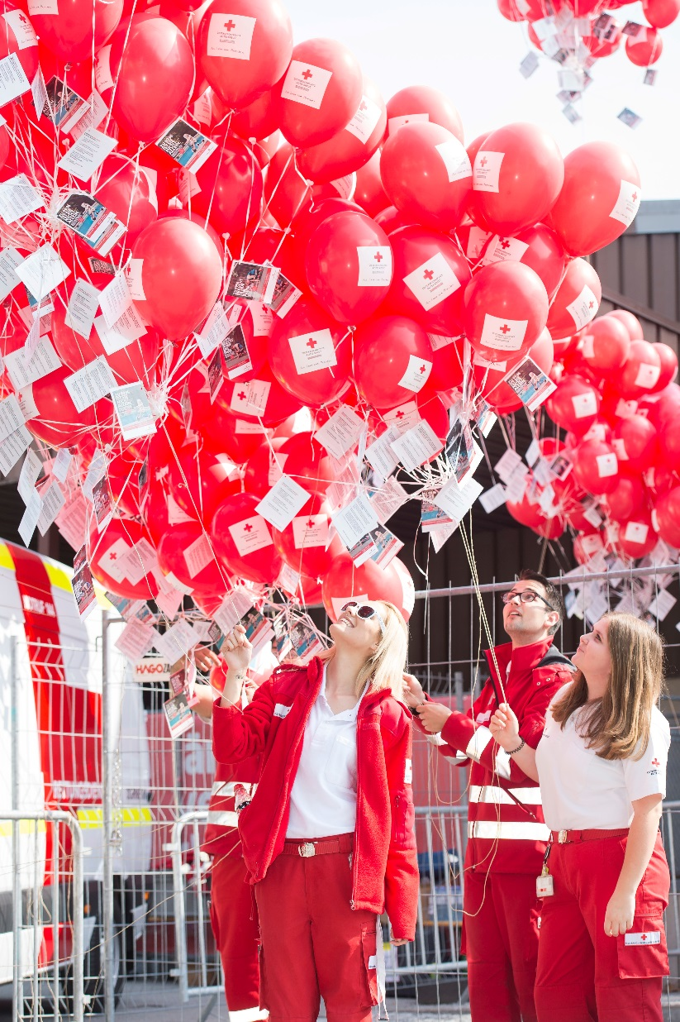
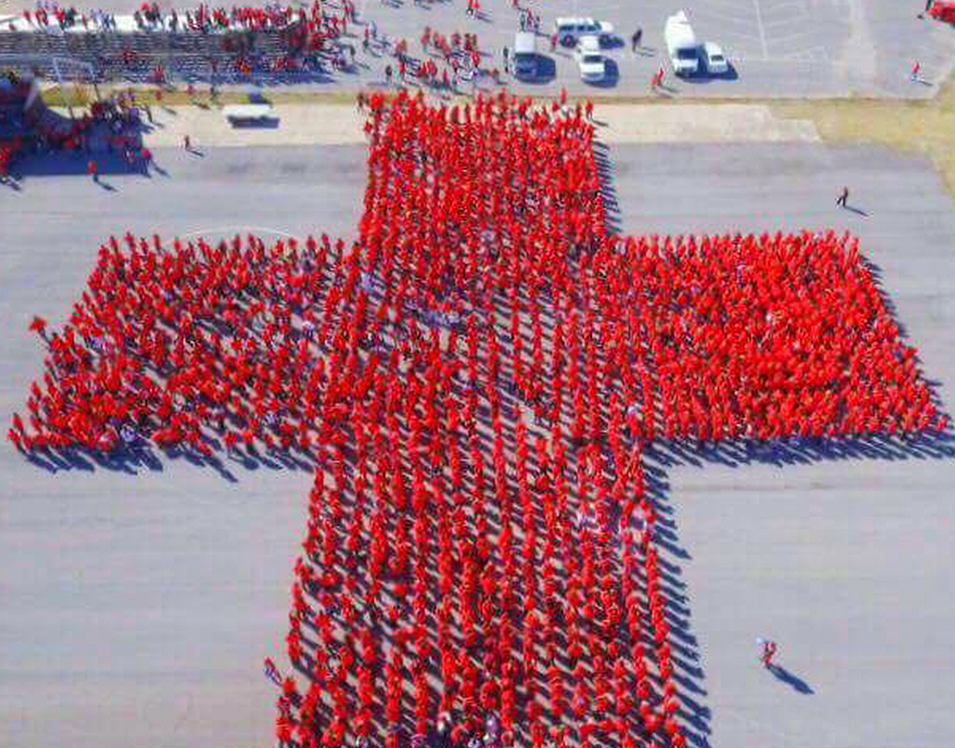
FAEEN 2021
Words from the ROE

Slide 4
What is the FA harmonization pack?

Slide 5
GFARC launched the “harmonization” pack.
February 2021
01
#Contextualization
#Evidence-based
03
Guidelines
IFAA
02
Platform
#Harmonization #PilotTest #Recognition #Quality #Assessement
#MarketPlace #SharingKnowledge #Ressources

Slide 6
International First Aid Attestation
2021, Ukraine

Slide 7
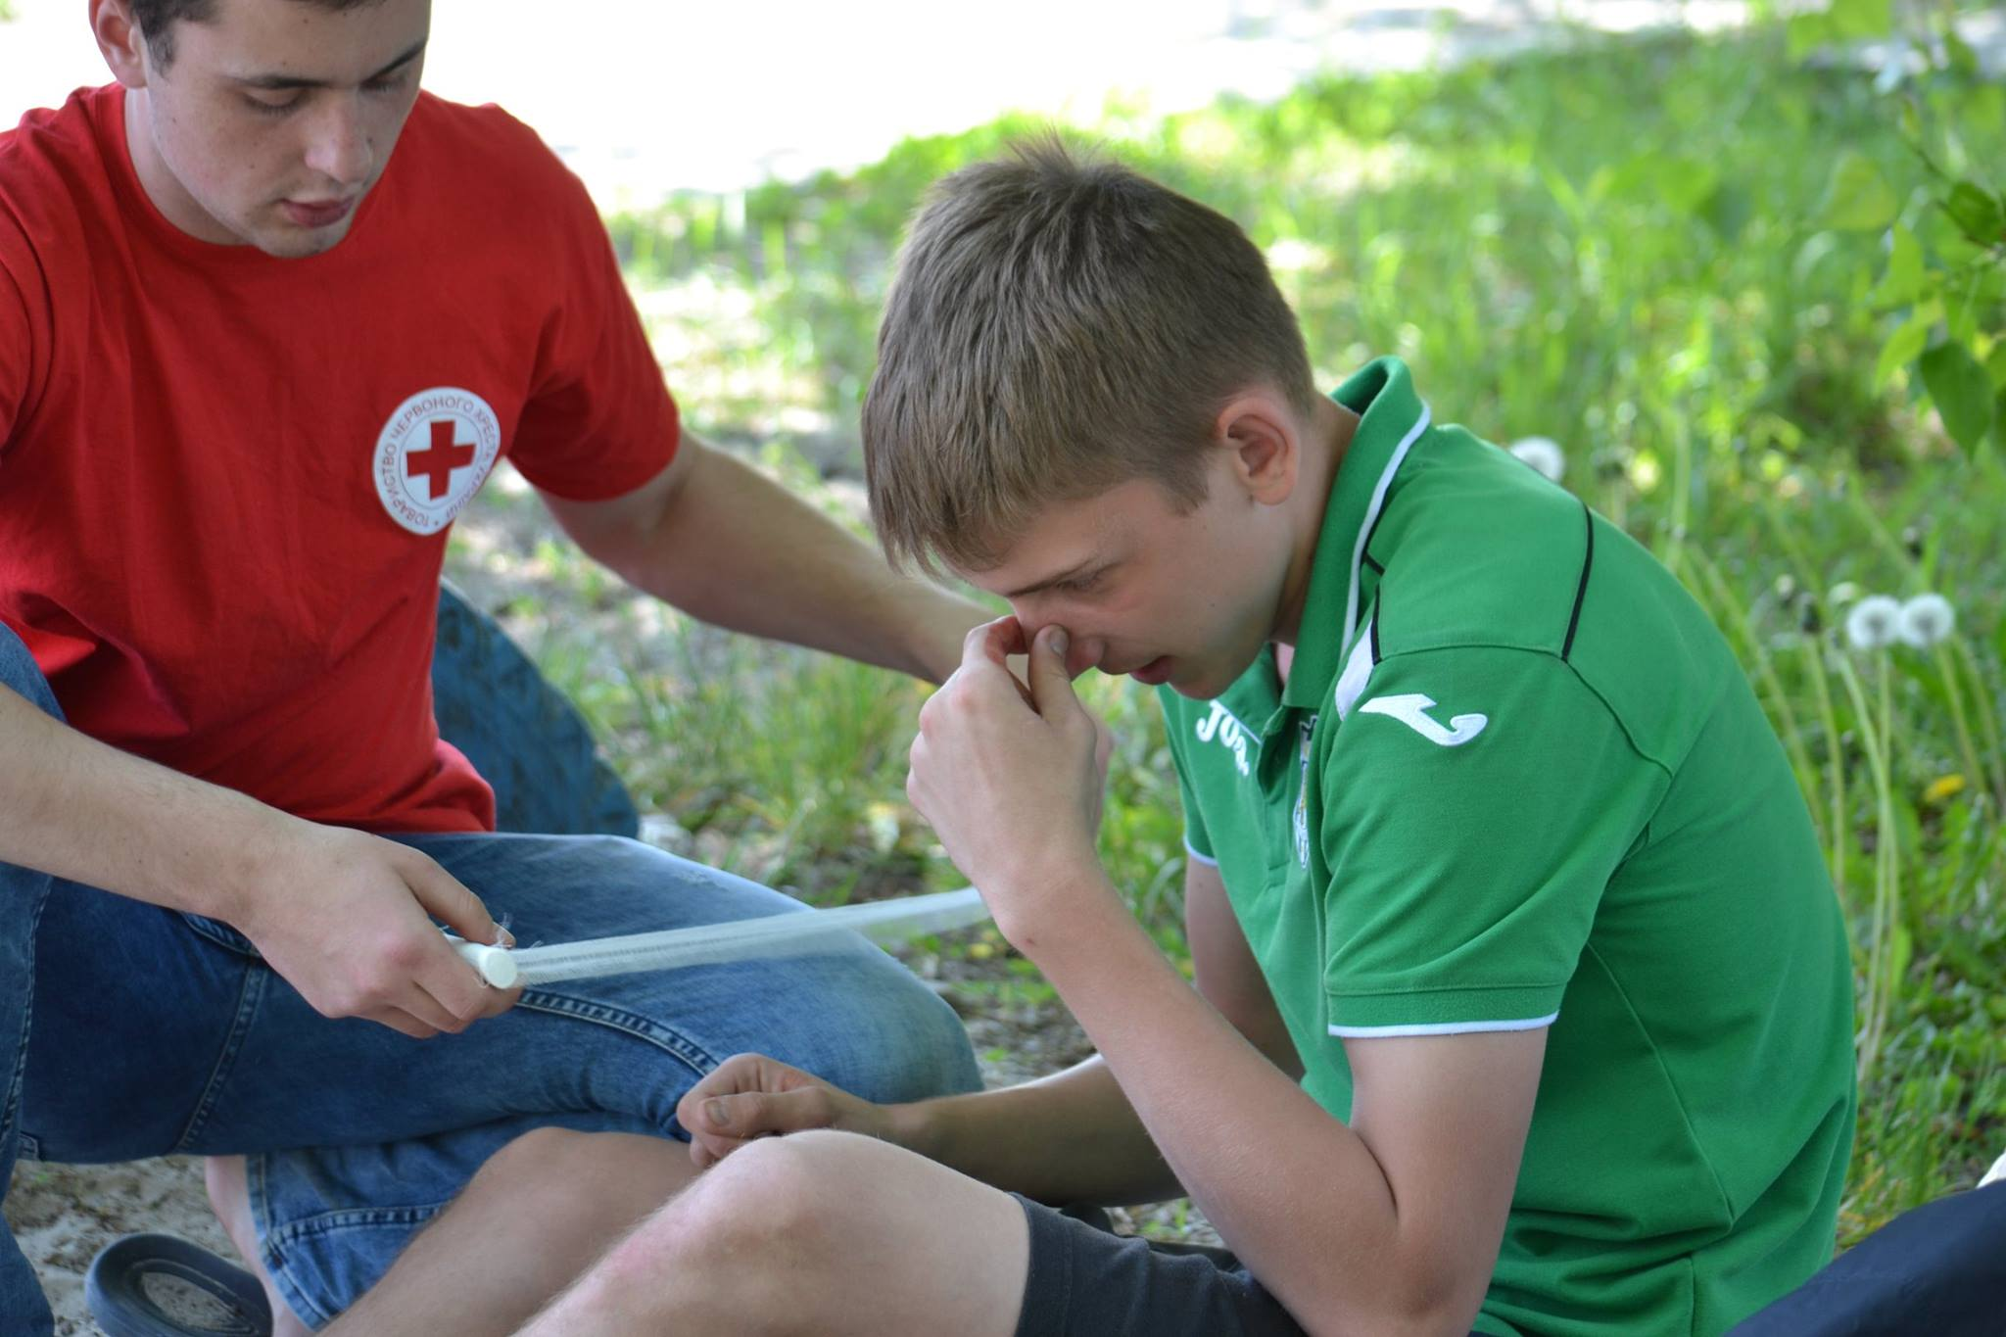
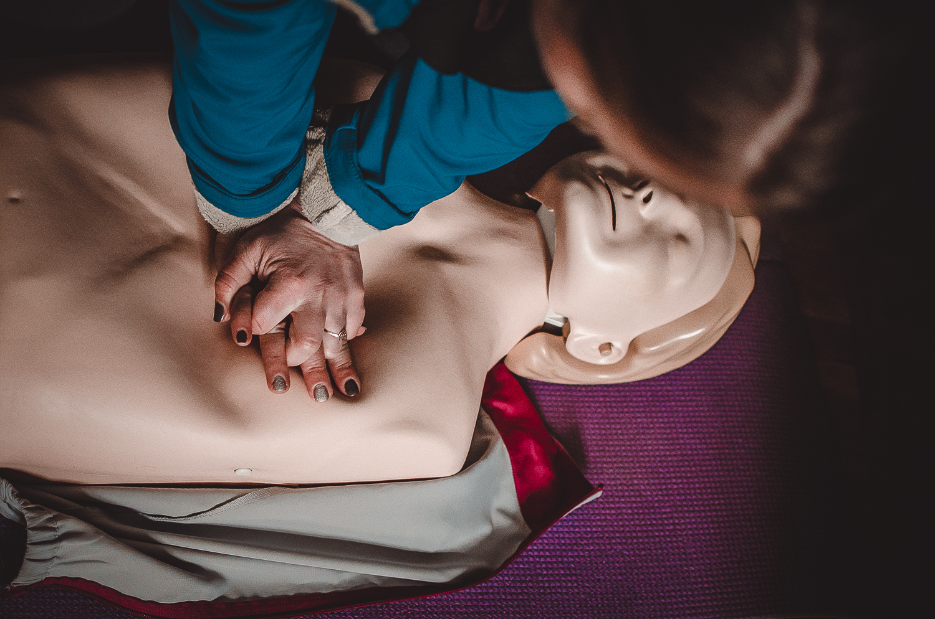
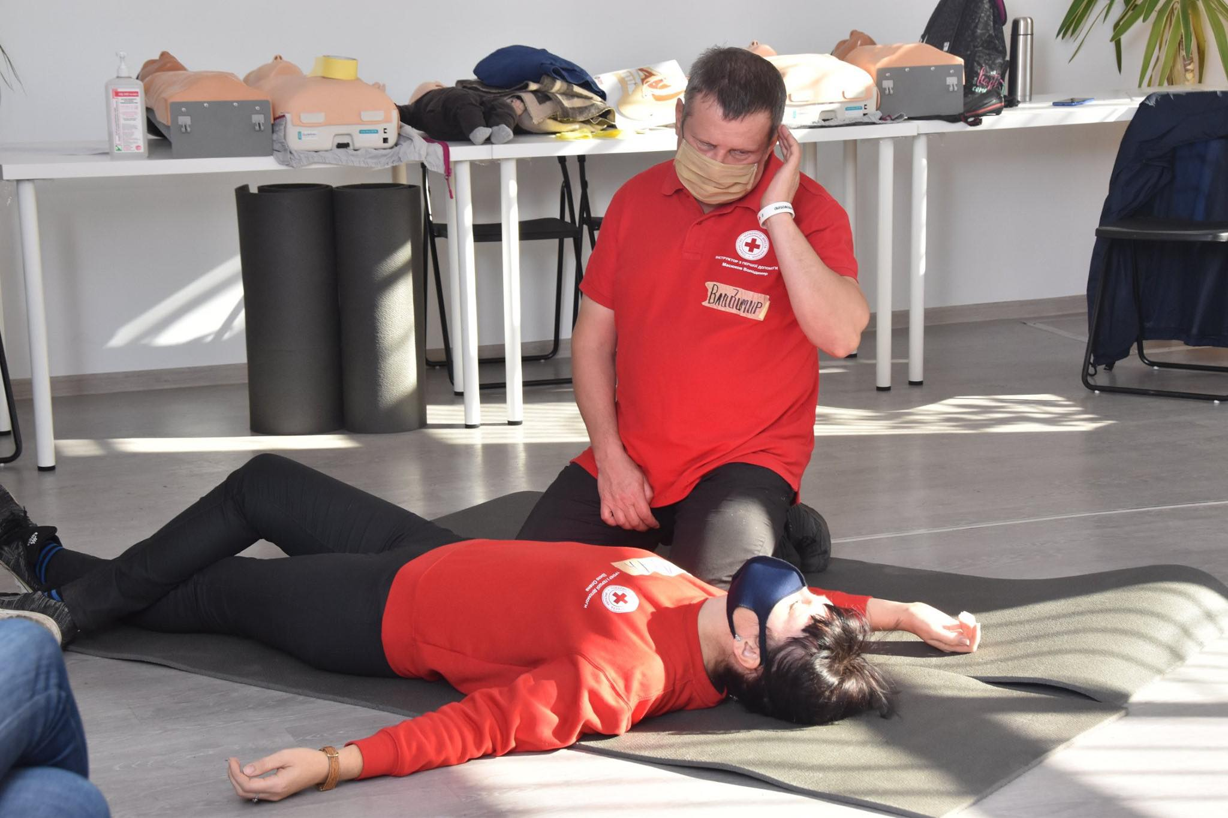
Background
The first certification of URCS first aid programmes was in 2011, re-certification in 2016.
URCS had three programmers, a 6-hour, 12-hour and 48-hour first aid training programmes.
Фото
Фото
Фото

Slide 8
The attestation process in 2021
Preparations for the accreditation began in early 2020. It included the following steps:
- updating the problems covered by the programmes;
- forming the material and technical basis;
- the development of methodological materials for instructors and trainers;
adapting the curriculum to biological risks during the trainings and first aid, i.e. including topics on socio-prevalent infectious diseases such as HIV, TB, hepatitis, as well as covid 2019;
after the release of new first aid guidelines by the GFARC in February 2021, they have been incorporated into the URCS materials.

Slide 9
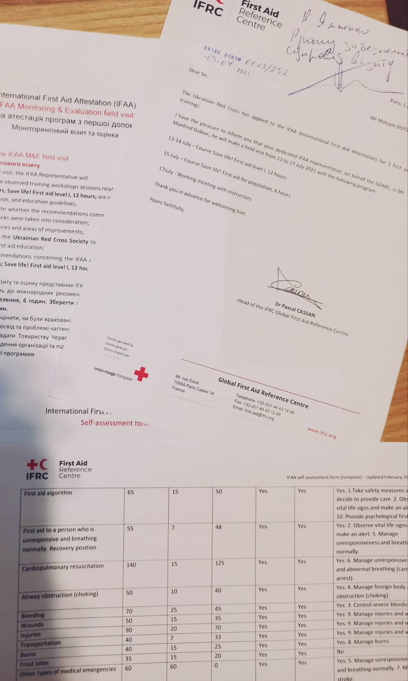
First step
As part of the first step:
submit a letter of application to the GFARC on the intention to take the attestation;
fill in the necessary documentation package in the form of tables;
receive feedback from the IFAA representative on the possibility of proceeding to step two.
The first step for URCS was two months long from starting to fill in the documents and receiving feedback on the opportunity to move to the second step (March-May 2021).
Фото

Slide 10
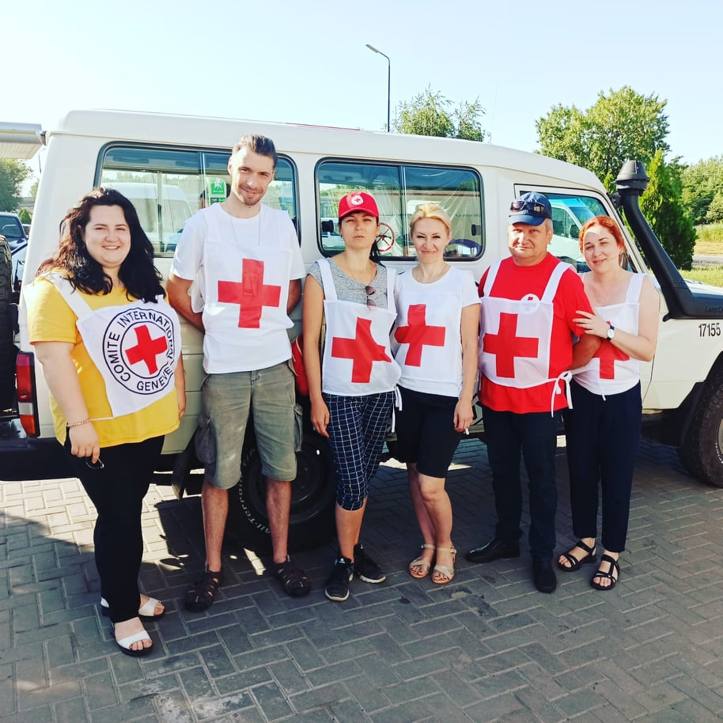
Second step
The IFAA representative's field visit plan was drawn up, taking into account the security regulations for staying in the country.
Different regions were chosen to demonstrate the delivery of training with unified standards.
One of the programme was demonstrated in the Donetsk region in a settlement along the line of contact with the armed conflict. The visit was accompanied by staff from the ICRC.
In addition, training sessions were held in Kiev.
The trainings were organized for different categories of the population by different instructors. This approach made it possible to demonstrate versatility in the presentation of the material and adherence to the structure of the modules.
Фото

Slide 11
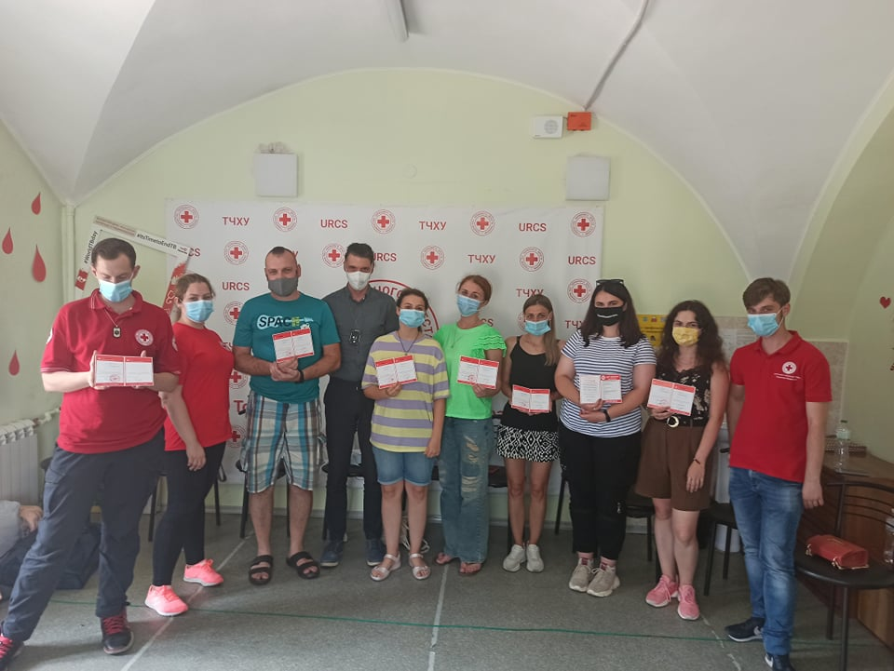
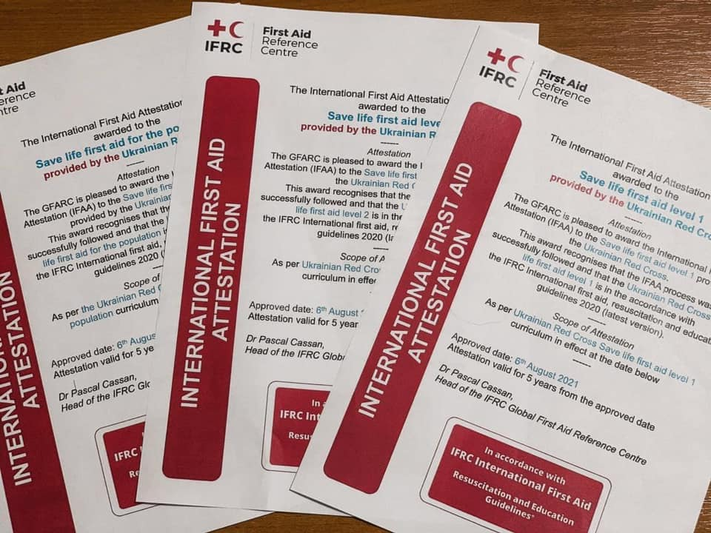
Final part
Фото
Фото
During the final discussion we drew up a development plan and identified important points to support GFARC.
On 6 August, URCS received international attestation for three first aid programmes.

Slide 12
Збройний
конфлікт
Збройний
конфлікт

Slide 13
Більше про нас:

Slide 14
Дякуємо за увагу!

Slide 15
Working groups
-
IFAA &
Platform

