Slide 1

Repositioning First Aid at the Center of IFRC Strategy 2030; Toward the renewed Commitment: Policy and Vision 2030: General assembly
Dr Bhanu Pratap
IFRC, Health and Care Department, Geveva
Dr Pascal Cassan
Global FA Reference Centre, Paris

Slide 2
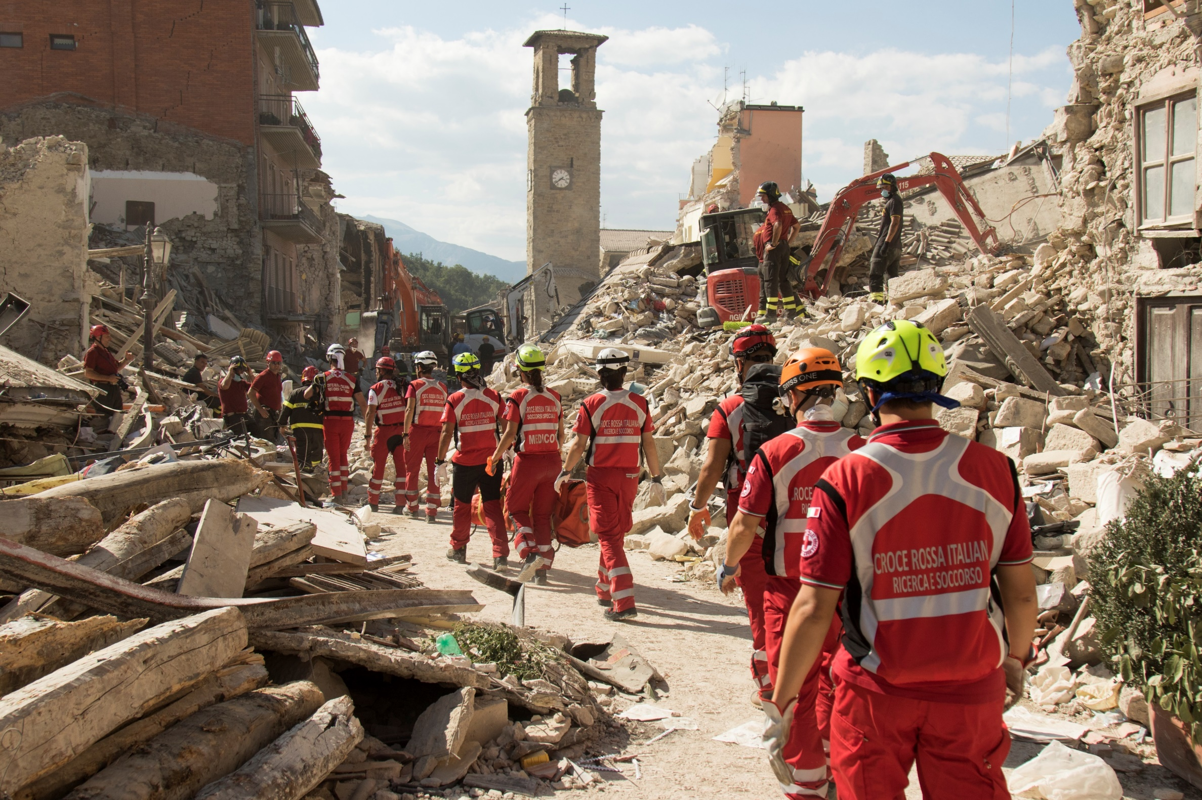
First Aid: Background
All 192 National Societies are engaged in first aid and/or resuscitation
46 million people reached and more than 20 million trained on First Aid every year
IFRC FA policy: adopted by the Governing Board in 2007.
The Global First Aid Vision 2015 – 2020: Focused on Reducing risk and building community resilience; Promoting an EB approach to FA;
A global survey: 2018 – 101 NS responded:
FA education remains a core area of each NS
NS are losing the market space with new actors coming into the FA ecosystem
GFARC REVIEW: 2020: The key findings : Team is highly motivated but not able to cater to the current request of NS
NS requesting to expand the scope of their first aid services, especially related to
  NS sustainable financial capacity through commercial FA
  Improve communication and advocacy
  Development of strategic alliances and partnerships at the local, national, and international levels

Slide 3
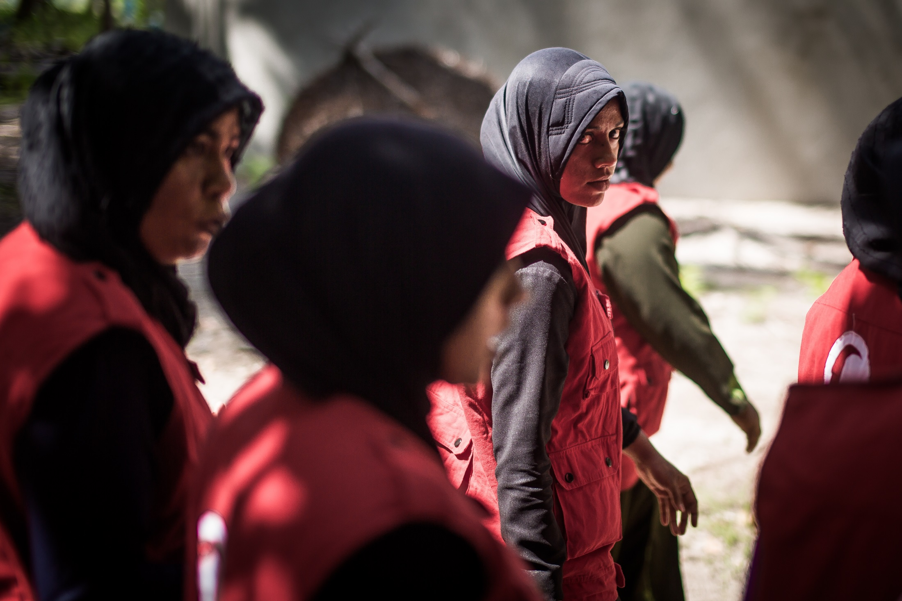
First Aid: Way Forward
Repositioning First Aid at the Center of IFRC Strategy 2030 and obtain a renewed commitment in membership:
1. Revise and update the IFRC FA policy:
    Out of date
    Certain elements are still relevant,
    Needs considerable revision to be in line with changes that have since taken place in the FA ecosystem,
2. Develop the IFRC FA Vision 2030 including the implementation framework:
    Relevant in all contexts,.
    Define the renewed ambition of the RCRC network & will include :
      Strategic priorities, including the resources and structural changes needed
      Monitor the progress through objectively verifiable indicators by 2025 and 2029.
3. Increased communication and advocacy efforts:
    World FA day, World Restart a heart day, other opportunities
    Side event during GA with NS and IFRC

Slide 4
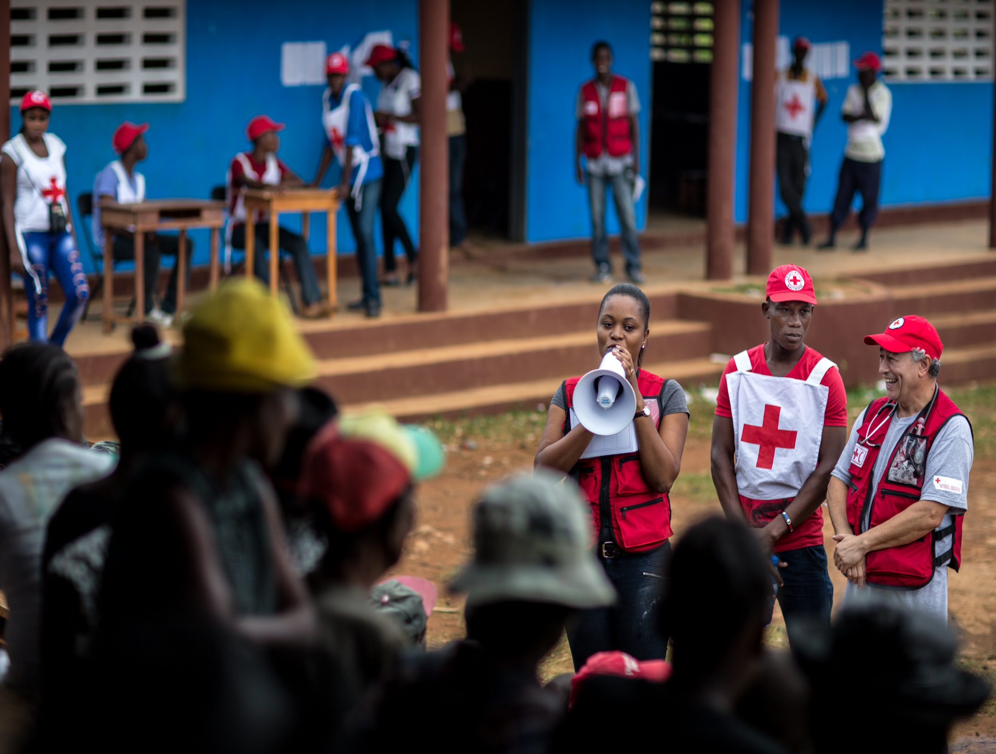
First Aid: Key steps
Repositioning FA paper finalized
Joint announcement by American RC, French RC and IFRC for the initiative on FA: EoI
Full time staff: 3 First Aid officer (American, Canadian and French Red Cross)
Establishment of extensive consultation mechanisms:
2 Technical Working groups: Policy and Vision:
Under TWG Vision: At least 6 sub-working groups : Vision and framework on the following 6 key areas:
  Commercial FA
  FA and resuscitation education and training
  FA & resuscitation in operations, prehospital health care, and healthcare institutions
  FA and CPR in schools
  FA and resuscitation standards and qualification
  Research, Evaluation, Advocacy and Legislation
Steering Committee:
Multiple rounds of drafting, writeshop, consultations with membership and finalization of documents.
A resolution presenting The FA Policy and Vision for adoption at GA and potentially a side event.
.

Slide 5
Establishment of consultation mechanisms
Technical Working groups
FA Vision
6 sub- working groups
FA Policy
Steering Committee
representatives from 1 NS from each region, IFRC, the French Red Cross, the American Red Cross

Slide 6
Members
FA Policy
Tunisian Red Crescent
FA Vision
Netherlands Red Cross
Kenya Red Cross
Dominica Red Cross
Belgian Red Cross, Flanders
French Red Cross
Nepal Red Cross
IFRC MENA
Steering Committee
Philippines Red Cross
Swiss Red Cross
Nigerian Red Cross
Grenada Red Cross
French Red Cross
IFRC Secretariat
Austrian Red Cross
IFRC Cluster English speak Carribean
Canadian RC
Argentinian Red Cross
GFARC
American Red Cross

Slide 7
First Aid Vision
Six sub-working group members
Commercial First Aid
Netherlands Red Cross
Argentinian Red Cross
Monaco Red Cross
First Aid education and training
Fijis Red Cross
Liberia Red Cross
Sri Lanka Red Cross
Philippine Red Cross
Austrian Red Cross
First aid in operations or pre-hospital health care
ICRC Geneva
First aid in Schools
Gambia Red Cross
First aid Standards and Qualifications
Swiss Red Cross
Research, evidence, evaluation, promulgation and legislation
American Red Cross
Belgian Red Cross
New Zealand Red Cross
Egypt Red Crescent
Dominican Red Cross
Myanmar Red Cross
Pakistan Red Crescent Society
Argentinian Red Cross
Thai Red Cross
Kenyan Red Cross
Lithuanian Red Cross
French RC
Palestine Red Crescent
Canadian RC
Indonesian Red Cross Society
Trinidad and Tobago
IFRC Pacific Delegation
Pakistan Red Crescent
Mexican Red Cross
IFRC cluster Engl speak Carribean
French Red Cross
Ecuador Red Cross
German Red Cross
Sudanese Red Crescent Society
Estonia RC
Libyan Red Crescent
IFRC Geneva
Mexican Red Cross
Canadian Red Cross
Lebanese Red Cross
Pakistan Red Crescent
Hong Kong Branch
Philippine Red Cross
Mexican Red Cross
Malawi Red Cross
Mexican Red Cross
Slovak Red Cross
Red Cross of North Macedonia
French Red Cross
Bahamas Red Cross
Canadian Red Cross
Pakistan Red Crescent Society
Sri Lanka Red Cross
Rwanda Red Cross
Costa Rican Red Cross
Armenian Red Cross Society
Red Cross Society of China
Singapore Red Cross
Lebanese Red Cross
Saudi Arabia Red Crescent
IFRC Pacific Delegation
Uganda Red Cross
Austrian Red Cross
Swedish RC
Australia Red Cross
Georgia Red Cross
New Zealand
Slovenia
IFRC Cluster English speak Carribean
Jamaica RC
Pakistan Red Crescent
Hong Kong Branch

Slide 8
Technical Working Groups Launching – July 2021
7 initial meetings completed – August 2021
(FA Policy Group and FA Vision sub-working groups)
Selection of co-chairs and finalization of workplans – August 2021
Ongoing review, research and discussion of Draft 0 and existing resources – August 2021
Development of Draft 1 ( FA Policy and FA Vision) – September 2021
Where are we now?

Slide 9
Next Steps
Write-shops to produce the first draft of vision and Policy
Extensive Consultations with membership on drafts
Steering committee meeting
Second Draft of Policy and vision
Working group meeting to finalize the draft
Final Draft of the vision and policy shared with SC for approval
Plans for side events and workshops at the GA developed.
Drafts to be shared with membership for inputs.
The Policy, vision adoption & side event for renewed commitment at GA
The final layout, publication, & distribution of the Policy & vision post GA

Slide 10
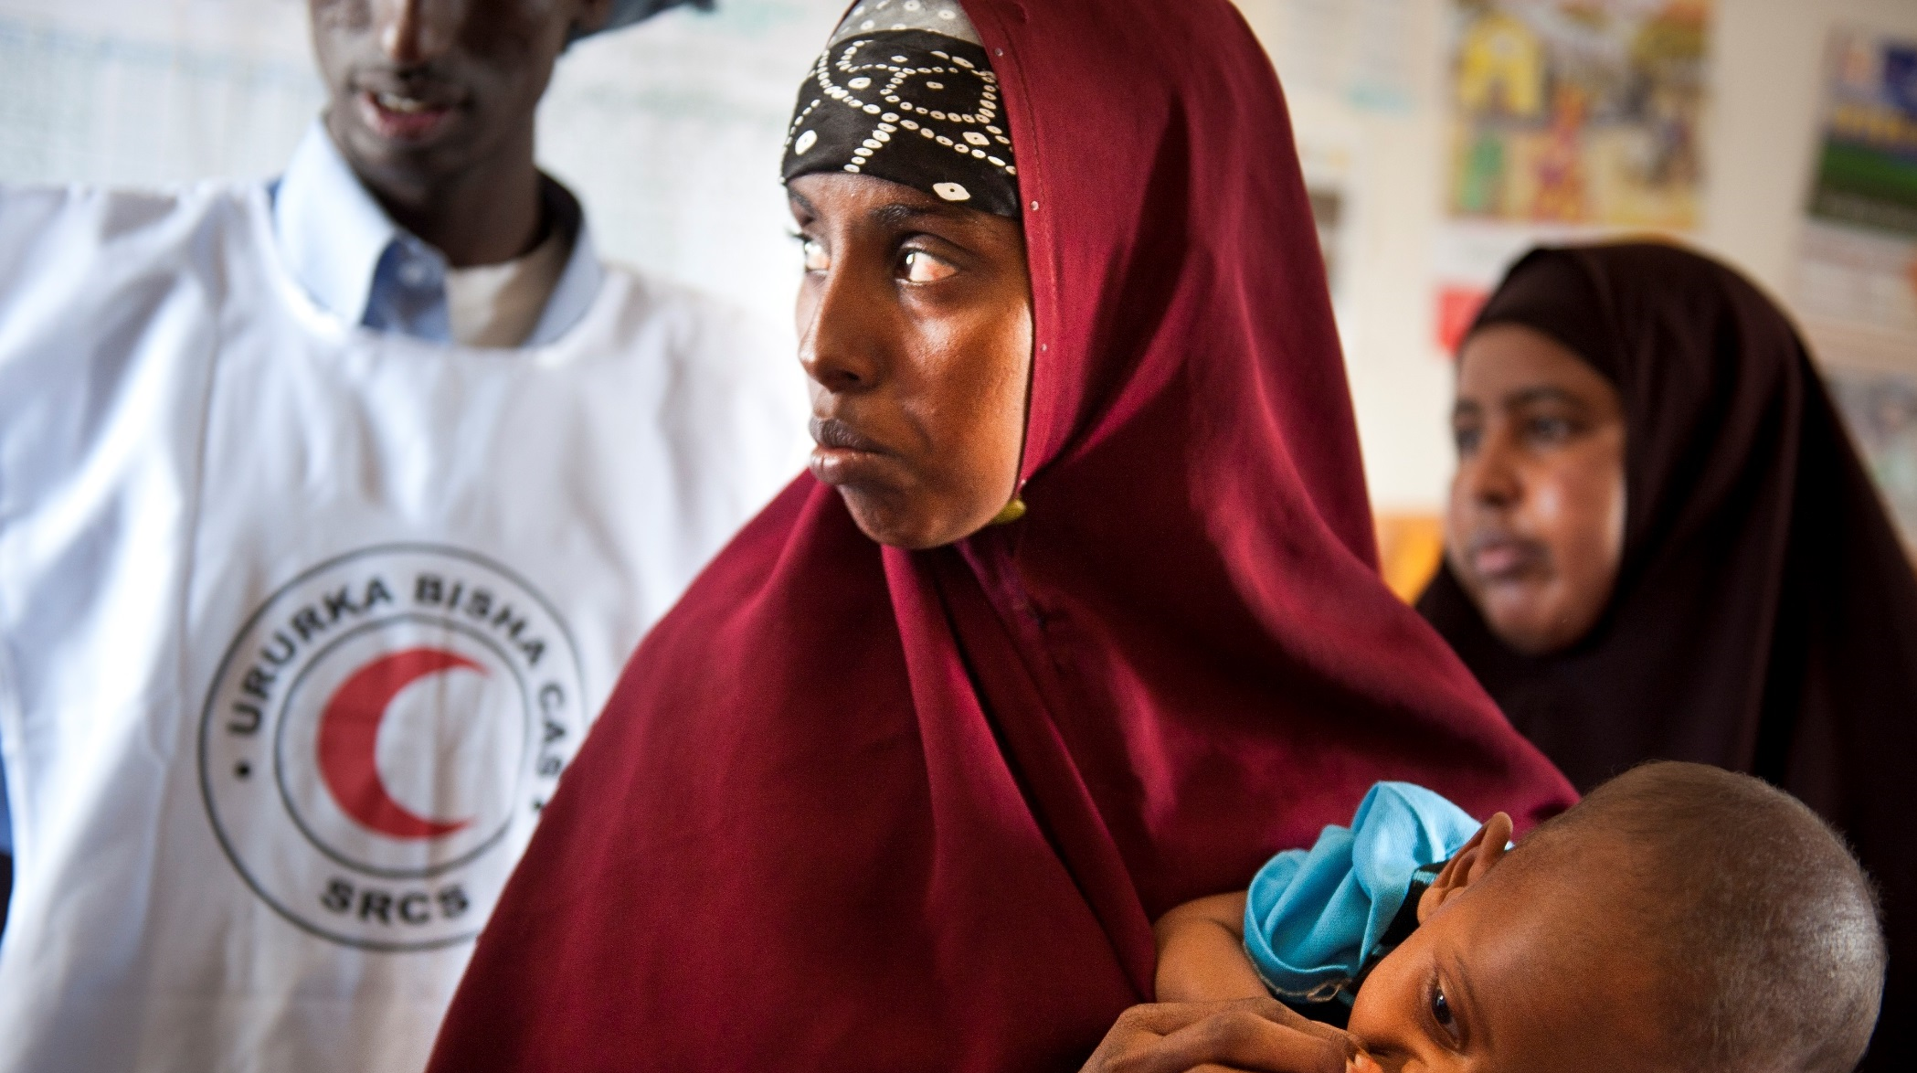









How can we work together?
How can we work together?
Disseminate the MHPSS policy, IC resolution and the roadmap within your network
Disseminate the Concept note and ToRs for NS policy and Vision within your network
Be a champion for First Aid
Get involved and engaged in priority action area working groups
Encourage your government and National Society to sign, commit and implement the 5 MHPSS pledges
Psychological first aid for all
Encourage your NS and others NS to join and commit to TWG and consultation mechanisms
First Aid advocacy and communications efforts

Slide 11

Thank You!
For more information, please contact:
Dr Bhanu Pratap,
Senior Officer - Health and Care Department
IFRC, Geneva
bhanu.pratap@ifrc.org
Global First Aid Reference Centre
First.aid@ifrc.org

