Slide 1
Outcomes measurement
Emily Oliver (in place of Christine Boase)– British Red Cross
Dovydas Bajarūnas – Lithuanian Red Cross
Ketevan Mindeli – Georgian Red Cross
“While most National Societies seem to have a system in place for collecting some information from learners, more needs to be done to support education outcome measurement, and the analysis and application of that data to improve effectiveness”.
Notes:
In the agenda this session is described as a keynote speech followed by a workshop. I would like to mix it up a bit, so we have a bit of talking, then an activity, then some more talking, a presentation, and so on. Outcomes measurement can be rather a dry topic so I hope this approach keeps you awake.
Introduce Dovydas and Keti.

Slide 2
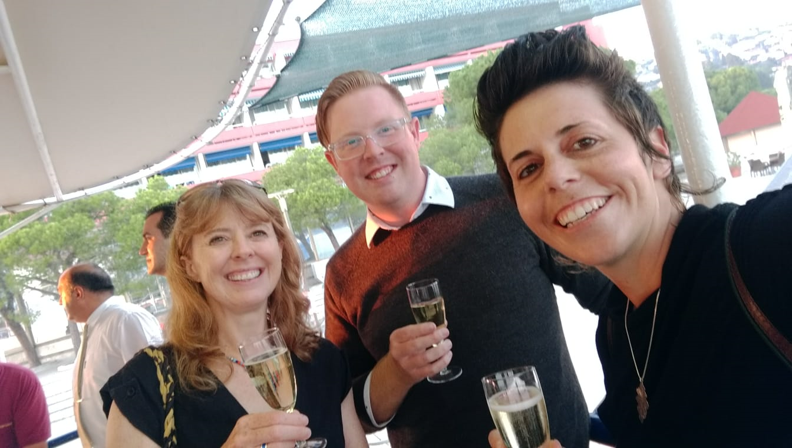
Notes:
Christine Boase can’t be here – she did most of the work. She has produced a toolkit for NS on outcomes measurement. It’s still in draft form and this session will help us to understand if it contains the right level of information for you. In the next month or so we will finish it and it will be available for you all.

Slide 3
On your BLUE post-it
How confident are you that you could measure the effectiveness of a first aid course?
VERY
QUITE
NOT SURE
NOT VERY
NOT AT ALL
Notes:
To start with you each have 2 pot-it notes: a pink one and a blue one. You need to keep hold of both of these. No swapping with your neighbour! They should both have the same number on.
Please take the Blue post-it and write on it how confident are you that you could measure the effectiveness of a first aid course. Any course that you are familiar with in your country. When you have written your answer, please stick it on the wall in the corresponding part of the scale.

Slide 4
What did you mean by ‘effectiveness’?
CHANGE
Knowledge?
Skills?
Willingness to act?
Notes:
All of you were thinking of something in particular when you answered that question. What was it? Please discuss with your neighbour for 2 minutes what it was that you had in your head when you were thinking about effectiveness.
Hands up how many were thinking about knowledge? Skills? Willingness? Confidence? Anything else?
Whatever was in your mind, the important thing for outcomes was that the learner experienced some sort of change.

Slide 5
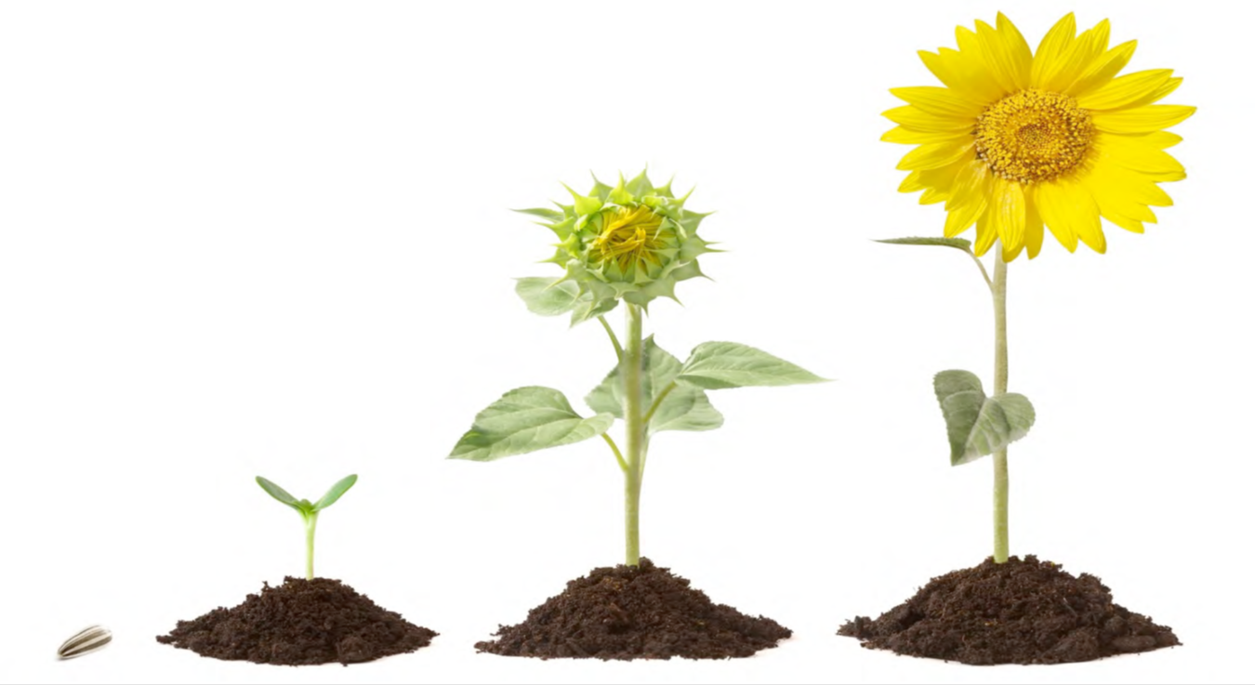
This Photo by Unknown Author is licensed under CC BY-NC-ND
Notes:
To measure change, it follows that you need a starting point and an end point. Somehow you need to understand where learners are before they learn, and where they get to after they learn.
How many of you currently measure change in your learners before and after and calculate the difference? Hands up.

Slide 6
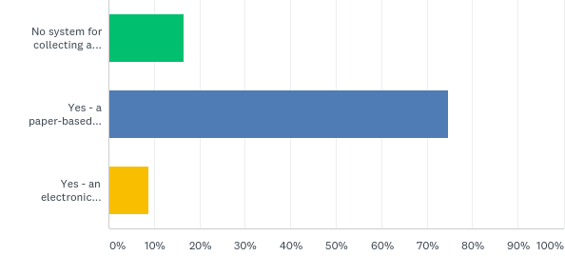
Q6. Does your National Society have a system already in place to collect information from all learners (like feedback on courses or learning outcomes) before, during or after a first aid course?
Answered: 91 Skipped: 2
Notes:
We know that a lot of NS have a system for collecting some data – this survey was done in 2018 and it’s great to see so many NS have a system of some kind.

Slide 7
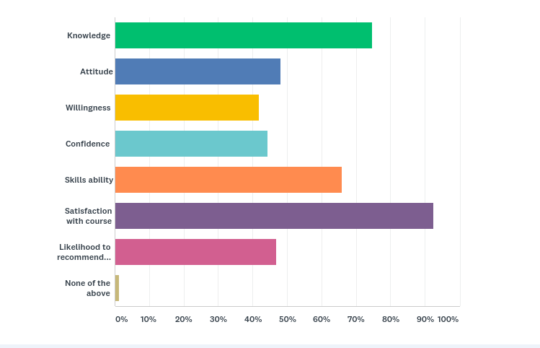
Q7. Which of the following information from learners does your National Society collect and measure?
Answered: 79 Skipped: 14
Notes:
We can see here what information is collected from learners. We don’t have a graph to show us how many do before and after learning measurements, but we can see that data on a number of outcomes is collected.

Slide 8

What is your education for?
What do you want your learners to leave with?
Notes:
What you measure, what outcomes you want to know about depends entirely on what your education is for. As an educator, what is it that you want your learners to leave with? Your answers to these questions are the outcomes that you want to see.
Whether you want the learners to leave with skills that they are confident to use, knowledge that they can apply – even under the pressure of a scary situation, a change in attitude about who they help, or an understanding of what their role is in an emergency, you will not know for sure whether you have achieved that outcome if you don’t measure it.

Slide 9
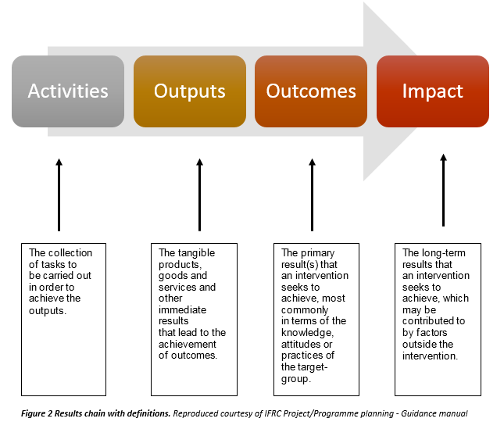
Notes:
Any education intervention could be organised using this results chain which can help to define what we mean by outcomes. For this morning’s session, we could say that the exercises that you are going to do are the activities, the outputs are your conversations and what you conclude from those conversations that you write down on flip charts; the outcomes are what you take away in terms of understanding of outcomes measurement, and the impact is any change that you implement back home as a result of this session.

Slide 10

Stockholm, Sweden Oct 3-5, 2019
Georgia Red Cross Society outcome project
Notes:
Part of the OM project that Christine Boase was involved with was working with a number of NS to test some methods. Now we’re going to hear from the Georgia Red Cross, particularly about what they decided to measure and how. Ketevan Mindelli.

Slide 11

Georgia Red Cross Society outcome project
The aims of the project were:
to increase GRCS’ understanding of the quality of first aid education in Georgia
to test the operational requirements of evaluation.

Slide 12
Georgia Red Cross Society outcome project
The target audience of the project :
Selected 4000 external training participants of the trainings with duration of 4, 8, 16, 24 hrs and other (in case of existence)
      School children
      students,
      Guides,
      People living in remote areas
      Participants of the commercial trainings
      Other groups in case of existence
3183 responses have been processed from ten participating GRCS branches

Slide 13
Georgia Red Cross Society outcome project
The tools and process of evaluation:
For the evaluation there were used evaluation form/ questionnaire and batch header that were translated into Georgian language.
Evaluation forms were completed by training participants and batch header was completed by the trainer after each training course.

Slide 14
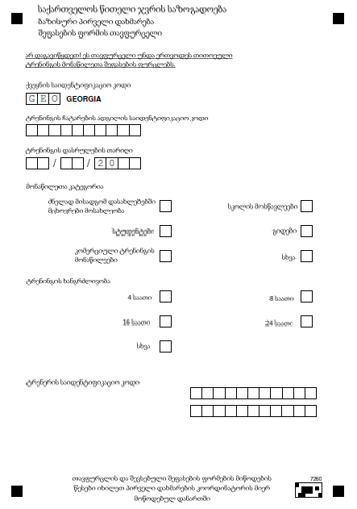
Batch header form
The batch header, completed by the trainer once per course, captured the following information:
Project site ID (Branch)
Course date
Learner audience type
Duration of course
Trainer ID

Slide 15
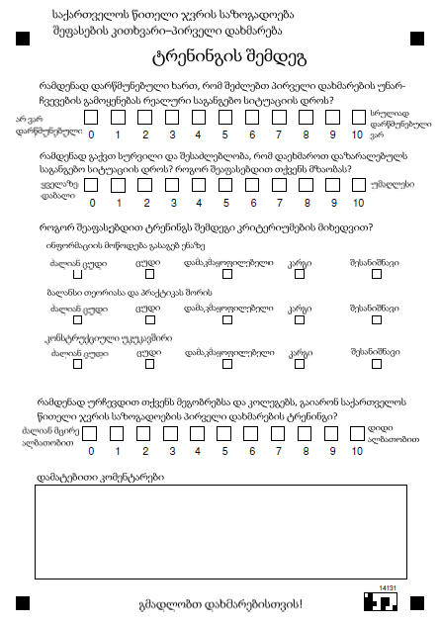

Evaluation form
The evaluation form, completed by each
learner asked them the following:
How confident do you feel that you can use these
skills in a real emergency? 0-10 (Asked before AND after)
How willing are you to help someone in a real
emergency? 0-10 (Asked before AND after)
How would you rate the training delivery for
each of the following?
Presenting information clearly
Balance of theory to practical work
Providing constructive feedback
How likely are you to recommend Georgia
Red Cross first aid training to your friends and colleagues? 0 - 10
Please tell us more about your answers. ((Free text))

Slide 16

Outcome effect of branches
National averages:
Confidence 54
Willingness 54
Combined 54

Slide 17
Net promotor score
“Net Promoter Score®, or NPS®, measures customer experience and predicts business growth. This proven metric transformed the business world and now provides the core measurement for customer experience management programs the world round.”
“Use your NPS as the key measure of your customers’ overall perception of your brand.”
Satmetrix Systems

Slide 18

Georgia Red Cross Society outcome project
GRCS post-evaluation discussions:
Evaluation process results sharing;
Evaluation outcomes estimation;
Improvement plan elaboration.
GRCS post-evaluation actions:
Work on trainers skills` better development;
Organize more refresher trainings and practical simulations;
Modify training methodologies-become more interactive;
Learning by doing;

Slide 19
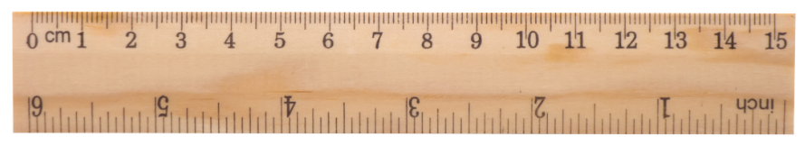
If a learning outcome is….
…the changes that occur in the learner’s knowledge, skills, attitudes or beliefs as a result of their learning experience
What can we measure?
Notes:
Spend 5 minutes in your groups and write down as many different things as you can about what outcomes you could measure.

Slide 20
Outcomes in first aid education…
Empathy – I can understand how that ill or injured person feels.
Attitude –
I think it’s a good thing to do, to help someone in an emergency.
Knowledge –
I know how to help.
Confidence –
I can help in an emergency.
Skills – I can show you I can help in an emergency
Behavioural expectation – I expect I will help someone in an emergency
Motivation – I must help in an emergency because…
Critical thinking – I can make decisions about what to do in an emergency and how to do it.
Resilience –
I can adapt and cope in an emergency
Helping behaviours – I helped someone in an emergency.
Willingness –
I will help in an emergency
Others???

Slide 21

What question do we ask?
Notes:
So you’ve decided what you want to measure. Deciding what question to ask is also important. For the exercises to follow we are not going to talk about outcomes to measure skills and knowledge. Many of you already do this in your own ways using assessments. For this session we are going to concentrate on other outcomes.

Slide 22
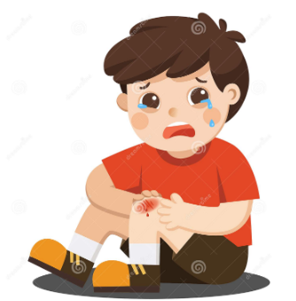


How confident are you to give first aid?
Notes:
You could ask “How confident are you to give first aid?
Can anyone think of any strengths or weaknesses about asking this question? If no replies – talk to your neighbour.
Strengths – It’s clear. It’s short. It covers first aid as a whole.
Weaknesses – everyone has a different idea of what the first aid situation might be and this will affect how confident you feel. Everyone has a different interpretation of confident, and a different interpretation of first aid.

Slide 23
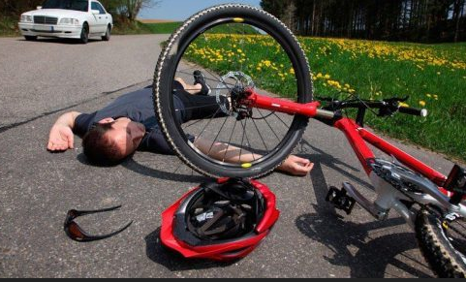
You are on a quiet street near your home and see a cyclist fall off his bike. His head is bleeding. How confident are you to give first aid?
Notes:
What about this question?
Again, what are the strengths and weaknesses of it?
Strengths: It’s specific about the injury and the setting and the person who is injured. There’s a lot more information in this question which means you narrow down the ambiguity for the learners who are answering it.
Weaknesses: You only know about the confidence of your learners in this particular situation. You can’t apply their answers to any other situation – a woman, rain, a broken leg.

Slide 24
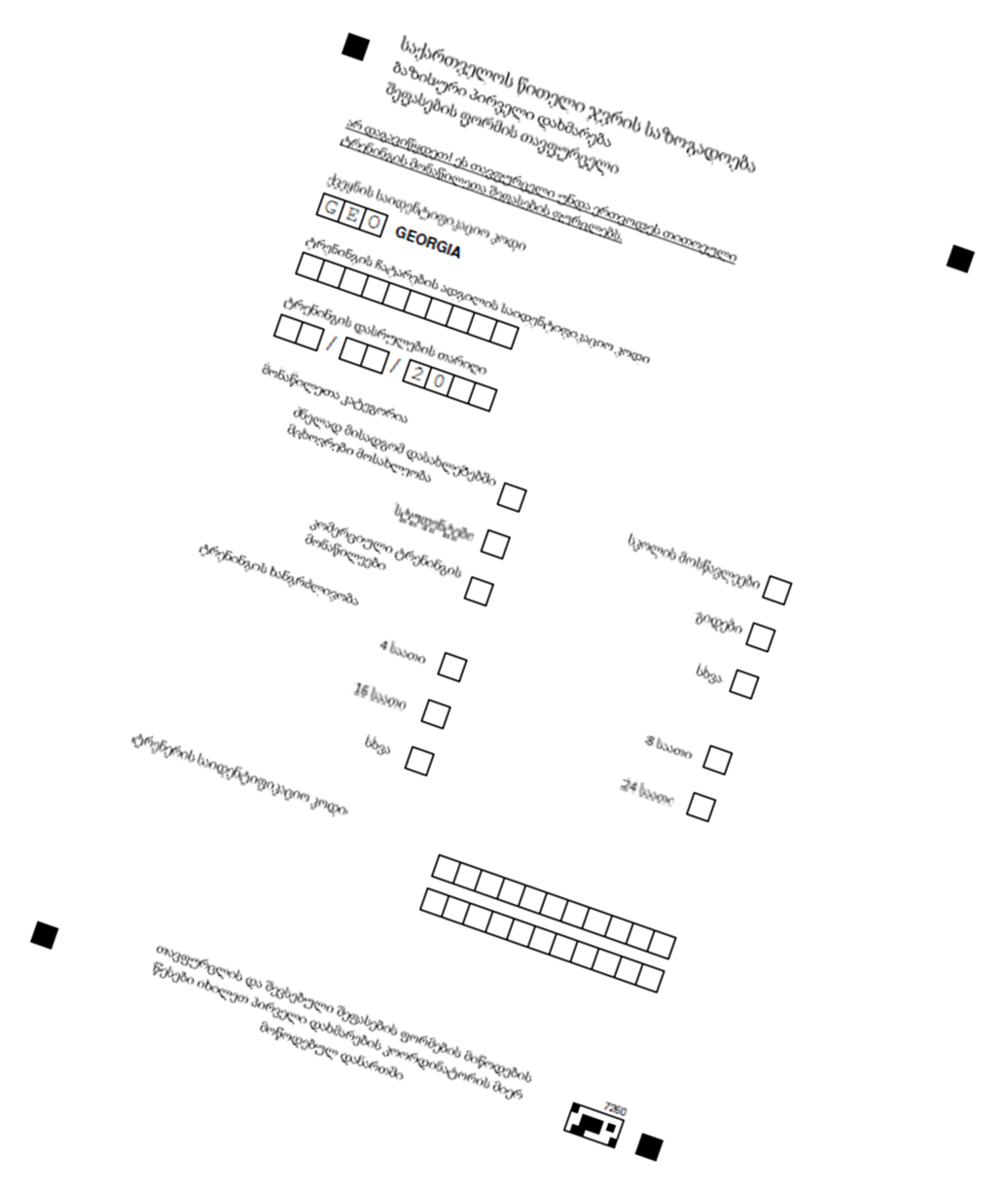


Collecting the data before and after learning
Notes:
So now you have put some thought into the outcome you want to measure and the question you will ask your learners to measure it. The next thing to think about is how to collect that data. Please spend 2 minutes as a group scribbling down the different physical tools you can use to collect data.
Feedback. And just like choosing which question to ask, each of these tools has different strengths and weaknesses. Some are much blunter tools than others. Some are appropriate for one audience but not another. Some might not be feasible because you have no ability to process the data.

Slide 25



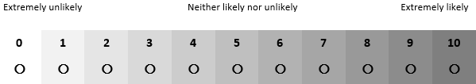
How can we measure it?
5 point Likert scale with 5 fixed anchors
7 point Likert scale with 2 fixed anchors
11 point Likert scale with 3 semantic anchors
Notes:
So now you have: your outcome, your question and your tool to collect data. But whatever tool you pick, you need to work out what scale you will use. But each of these has strengths and weaknesses, from how easy they are to use, to how much time you have available, to how much detail you want to be able to analyse.
I’m going to give you some ideas of scales that you can use.
The 5 point Likert scale can be used with fixed anchors. This means that you have defined what each point on the scale means, and, just like with the specific question, you can narrow down the inconsistency of interpretation. This scale can also be used in the form of smiley faces meaning you can use it for younger age groups, less literate groups, or foreign language learners.
The 7 point Likert scale is a popular ‘middle level’ scale to use. This is commonly used with just a fixed anchor at either end, allowing for more flexibility.
And the 11 point Likert scale. With this one and with the 7 point one you can use numbers rather than just descriptions which gives greater potential for analysis.

Slide 26
What are the strengths and weaknesses of different measurement tools?
Who could you use each tool with?
Who could you not use it with?
What can it tell you?
What can’t it tell you?
How easy is it to use?
Notes:
Table exercise: On your tables you will find a learner group. Spend xx minutes discussing what the best tool would be for each learner group. Think about:
What are the strengths and weaknesses of the different outcomes measurement tools for this group?
What do you think will be the best tool to use?
How would you use it (e.g. electronic, post its, paper forms, hands up etc)

Slide 27

Case study: Lithuania Red Cross

Slide 28

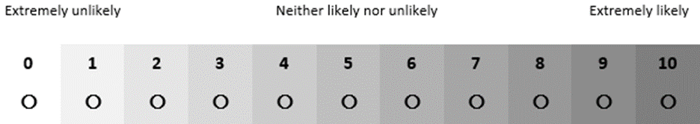
Calculations: the basics
For ordinal data you can calculate:
The mode – the most common response
The median – the middle response when all responses are arranged in order
The range/interquartile range – to show variance
For discrete data using a numbered scale you can find the mean (average) both for individual change and for group change
Notes:
Now we are going to look very briefly at the calculations that you need to do to get the change value to tell you how effective you have been.

Slide 29
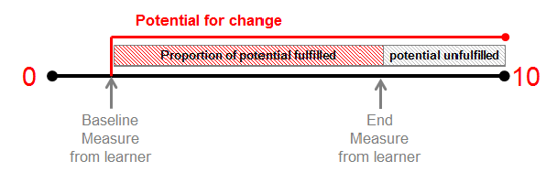
Education effectiveness is expressed as a % (Average Potential)
E.g. Assuming the learner started at 2 and ended at 8…we were 75% effective at helping them fulfil their potential for improving. (Potential at baseline was 80% of our scale. Their change was 60% of the scale. 60/80 = 75%)
Notes:
In BRC and GRC we used AP

Slide 30


Using the outcomes data to shape decisions
Notes:
The point of all of this measuring is, of course, to shape decisions. Should we change the content or presentation of a course to make it more effective? Do we have the right educators for reaching a particular audience?

Slide 31
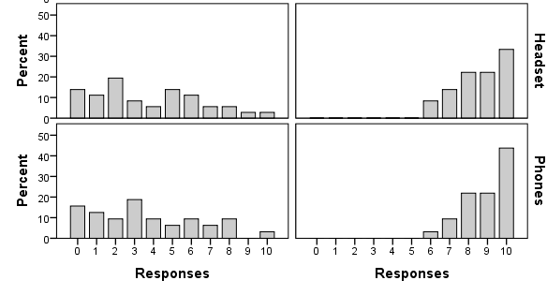


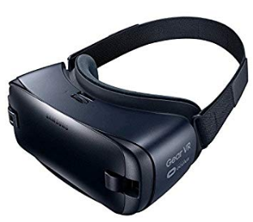

You are walking through a busy shopping centre when you see someone you don’t know collapse. How likely are you to give first aid?
Notes:
In the British Red Cross we used outcomes measurement to help us make decisions about what to do next with our 360 bystander video. Yesterday many of you, I hope, participated in a workshop about the video. Through analysis, we revealed that learners liked it and that it was effective at changing minds about helping. But there was also a financial question. We wanted to know if we really needed to invest in headsets for it to work well, or if learners could just watch it on their phones. The pre-learning distribution is similar for both cohorts, and so is the post learning. If anything, the phone was marginally more popular than the headset.
This was great news as it meant we did not need to invest in a lot of headsets for learners.

Slide 32
BRC Crisis Education Outcome Data
Everyday First Aid Launches
Educator development pathway launches
Reshaping Our Work
Coaching Model implemented
Notes:
We can also use data collection for outcome measurements to track progress over time and understanding what could be attributable. This graph shows the journey the BRC went on when it changed its education approach. We used a calculation of confidence and willingness change to see what effect changes to our programme had.

Slide 33
But aren’t there are other things to evaluate?
Outcomes Is the learner more confident, more knowledgeable, more able to do first aid? | Impact How many people does the learner help - how many lives do they save?
Satisfaction Would the learner recommend the course to their friends? | Retention How long does the learner remember what they learned ?
Notes:
Yes, and they are all important. Measuring each will give us different information that can be used in different ways. But measuring outcomes are what will help us improve educational effectiveness.

Slide 34
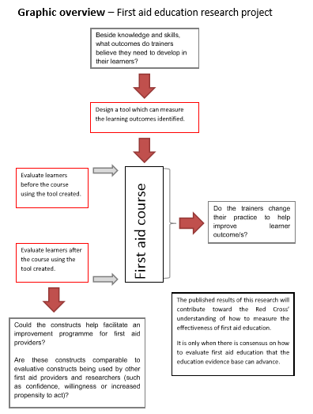
Notes:
We have a final example from France, where the French Red Cross is working with the Andorran Red Cross. I won’t go into detail, but they have here produced a useful algorithm for describing the process they are following.

Slide 35
Don’t forget…..
Keep a record of who your learners were
What did you cover in the session?
When did it take place
How long did it last

Slide 36

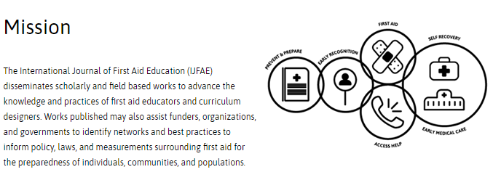

Slide 37
On your PINK post-it
How confident are you that you could measure the effectiveness of a first aid course?
VERY
QUITE
NOT SURE
NOT VERY
NOT AT ALL

