Slide 1
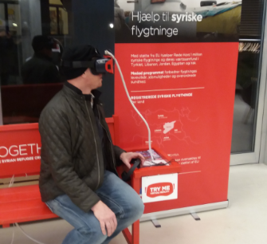
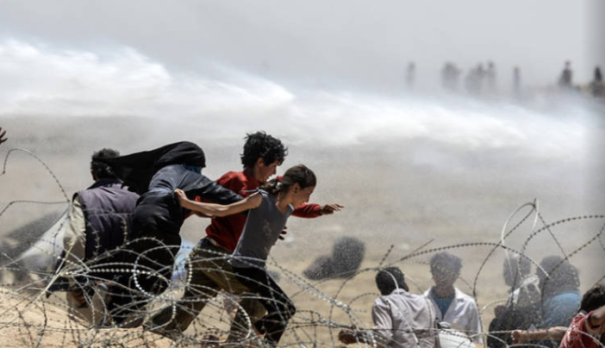
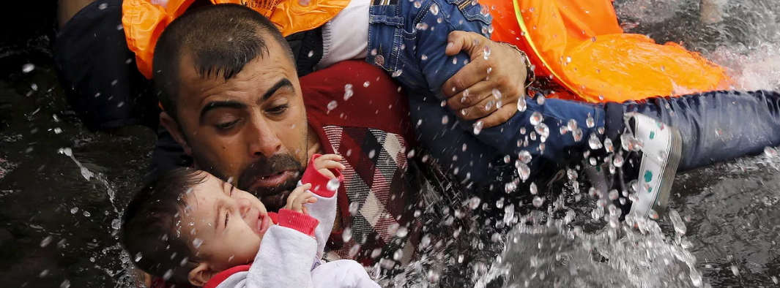
Notes:
Intro slide in plenary:
This is the reception area of the Danish Red Cross offices in Copenhagen. The first thing you are invited to do there is immerse yourself in a world of humanitarian crisis. It’s edgy and uncomfortable. Immediately you start questioning your own life: what if it was like these images, what if you felt that fear of conflict and war every day.
Our workshop this afternoon is going to look at an immersive experience for first aid. We have plundered the talents of the VR unit of the ICRC based in Bangkok to create a first aid scenario which could be faced almost anywhere in the world. But the workshop is not about the experience itself – you have had the chance to try it out over the last couple of days in your breaks. What we want and need to talk about is how it can be used: what’s its educational value? Does it have other value?
I’m delighted to share the session with Issam Naime from the ICRC in Geneva who has been helping the British Red Cross with this project.

Slide 2
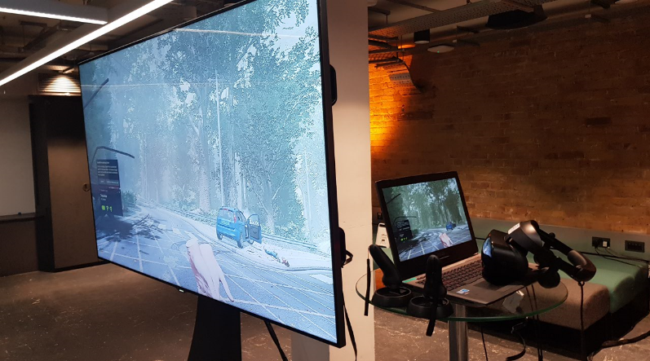
Issam Naime
Emily Oliver
Virtual reality
Notes:
Emily: Welcome to our session. As I said in the intro, this workshop will be about the potential of VR both as an educational tool and for other purposes.
We are going to start with an overview of the work of the ICRC in this area: why are they investing so much in VR, and what made them partner with BRC for the first aid project?
I will then talk briefly about the BRC project and where we have got to with it;
Issam will demonstrate the tool in case you have not seen it in action yet;
And we will spend the rest of the session discussing the challenges and opportunities that it affords.

Slide 3
Why VR? New tools: new topics What about first aid?
Issam Naime
Notes:
Issam

Slide 4
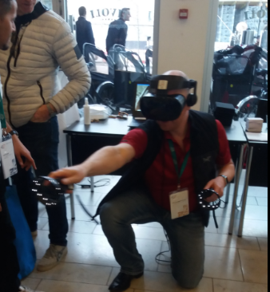
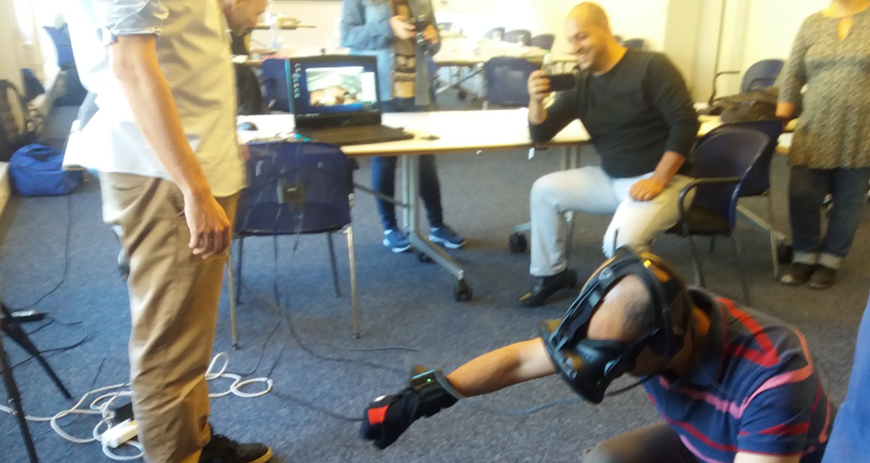
Notes:
The British Red Cross has been thinking about VR for some time. What if it could scale up our education? What if it could provide a freshness and excitement to learning first aid that helped a whole new cohort of people?
We explored some different technologies, and put together some costings and what you have here is the final product.
We did some user testing too: how would people find it to use? Was it intuitive? Were there aspects that were unconvincing? We tested it with some of our own first aid volunteers, with delegates at the Nordic First Aid conference in Copenhagen in March, and with Aviva – one of our high end donors and with a cross section of our staff. For each audience we collected feedback on quality, usability and impact. In general it was well liked – there were a few queries over the first aid actions, but as a concept, it was found to work very well.

Slide 5
How can the simulation best be used?
Notes:
When we asked about how the simulation could best be used, we got quite a variety of answers. The most common answer was for developing decision making skills, but developing emotional resilience, and as an awareness or engagement tool also came high on the list.

Slide 6
- What are the challenges of using this tool?
- What are the opportunities for using this tool?
- How can we take this forward to make it as useful as possible for the most number of people/NS?
Issam Naime
Emily Oliver
Virtual reality
Notes:
Discussion
What are the challenges of using this tool? (Cost of equipment, individual vs group engagement)
What are the opportunities for using this tool? (Getting people interested in learning, reaching people who don’t want to come on a course, demonstrating to donors what the Red Cross does etc etc)
How can we take this forward to make it as useful as possible for the most number of people/NS?

