Slide 1
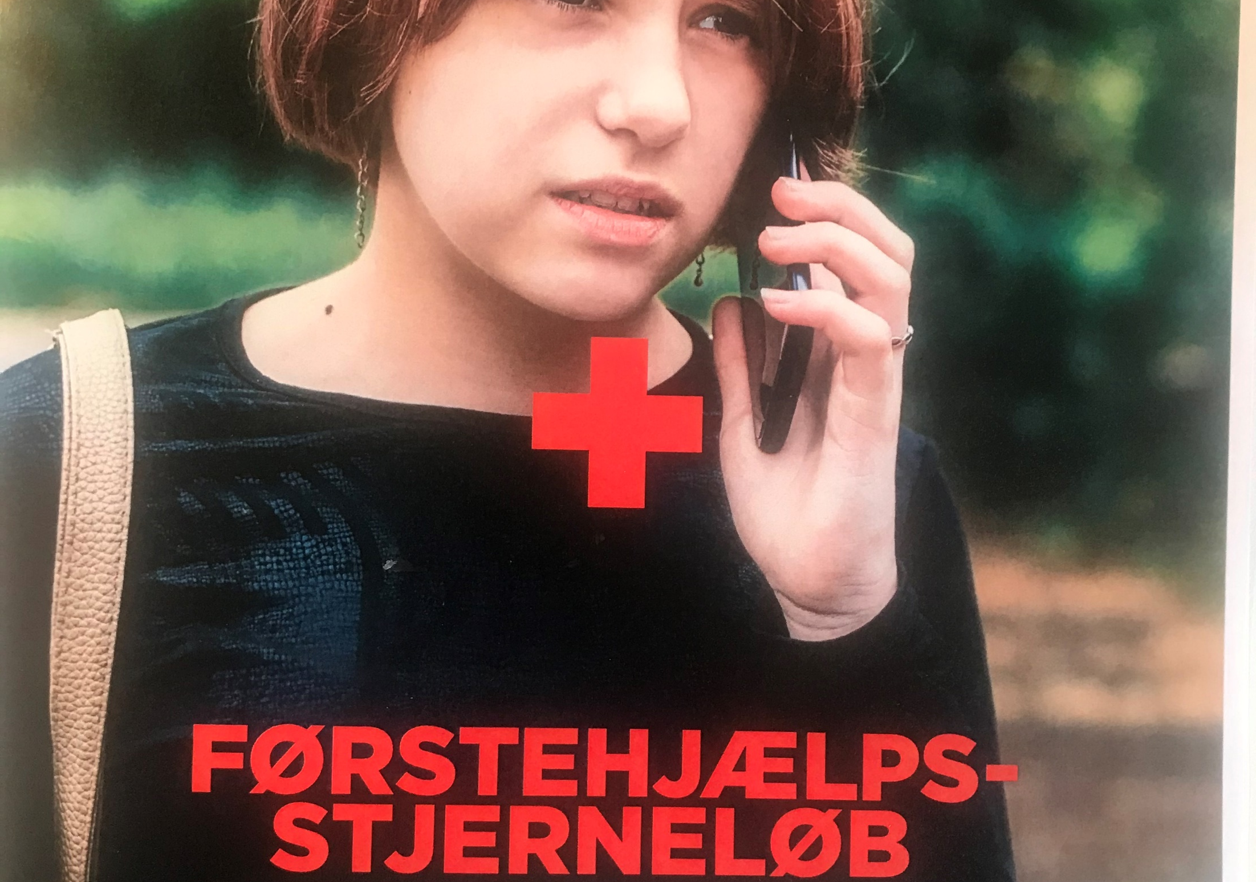
FIRST AID RUNNING EVENT
Notes:
First and in time of a pandemic
When the schools re-opened after weeks of lock down the teachers were encouraged to take the teaching outdoor to reduce the risk of spreading the virus.
We saw this as an opportunity to boost the first aid activity in the schools and wanted to make an easy” plug and play” material to the teachers.

Slide 2
Our focus
The 4 principals for first aid. We made a story about finding a woman lying on the road in a forest.
Children in the 3.th. and 4.th. grade (9-11 years)
It will take between 90-120 minutes
Material to download:
Teacher’s guide on how to do the run
Additional information on 4 principals
5 posts with questions
A poster with the 4 principals of first aid.

Slide 3
How to do the run
The teacher will gather the students outside, inform them that they are going for a small run with different post on first aid topics.
The teacher will ask if the know what first aid is? Who can give first aid, and why we should give first aid? Is there anything that we are afraid of by giving first aid?
The idea is to give the children confidents by talking about the important of knowing first aid and that we all are willing to help a person in distress, even though we might get a bit scared or nervous.
Notes:
The practice
First the teacher will gather the students outside, inform the about the they are going for a small run with different post on first aid topics.
Confidents
The teacher will ask if the know what first aid is? Who can give first aid, and why we should give first aid? Is there anything that we are afraid of by giving first aid?
The idea is to make the children to talk about the important of knowing first aid and that we all are willing to help a person in distress, even though we might get a bit scared or nervous.

Slide 4
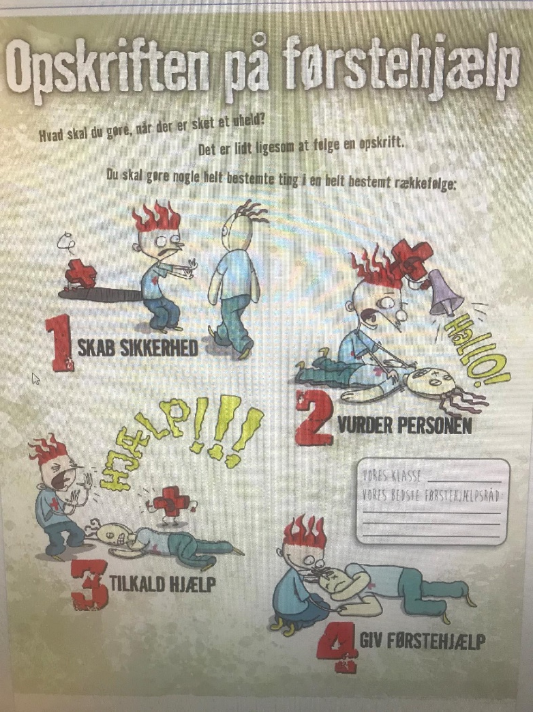
The recipe for first aid
The teacher will then go through the 4 principals and make the student discus each.
How do you Ensure safety? Why is it important?
Why do you need to access a casualty? How do access – explain A– B- C-? put you hand on your beast and feel how a normal breathing is.
How do you call for help? Who are you calling and what do they need to know?
Administer first aid: If a person is unconscious, is beathing and does not have big wounds, then put the person in recovery position.
If they have the time, they will practice the 4 principals and the A-B-C on each other and practice the recovery position.
The teacher will ask why the order of the 4 principals is important.
Notes:
The teacher will go through the 4 principals and make the student discus each.
How do you Ensure safety? Why is it important?
Why do you need to access a casualty? How do access – explain A– B- C-? put you hand on your beast and feel how a normal breathing is.
How do you call for help? Who are you calling what do they need to know?
Administer first aid: if a person is unconscious’s beathing and does not have big wounds, then put the person in recovery position.
If they have the time, they will practice A-B-C on each other and practice the recovery position. (if it is OK with the current ”corona rules”)
The teacher will ask why the order of the 4 principals is important.

Slide 5
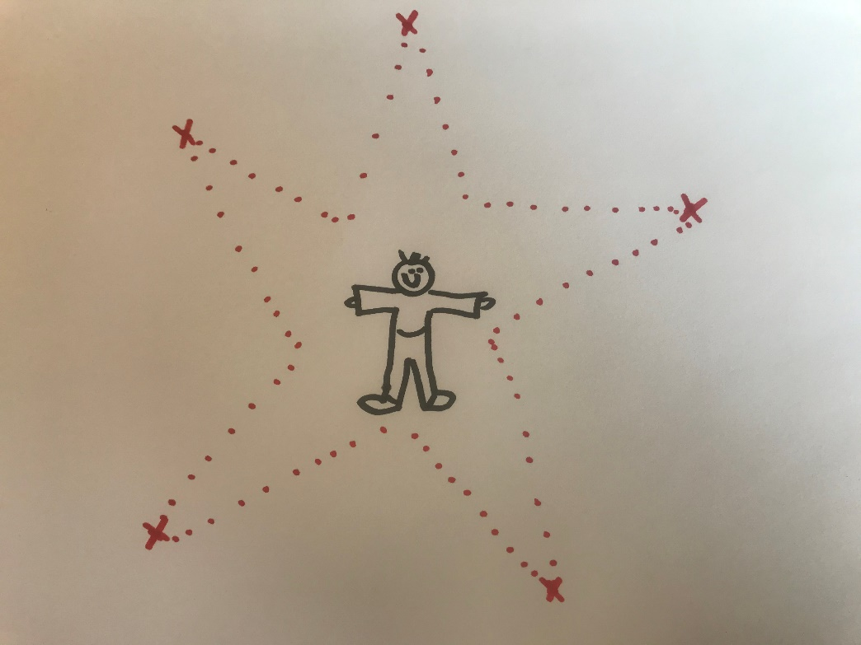
The run
The students will be divided into groups. Each group will go to one post, and solve the first question.
They will returned to the teacher with their answer, talk about it, and the go to a new post and solve question no 2 - and so forth..
They will go through the 4 principals again.
We have added a fifth question, on being a good friend. “What will you do if your classmate has seen an accident?”

Slide 6
The end..
When the students have been to all 5 poste, the teacher will gather the students again.
They will summarise, what is the most important thing of first aid? Why is the order of the principal is important, and they will go over the 4 principal again.
On the “poster with the recipe” we have made space so that the students can come up with their own best advice on first aid for their class.

Slide 7

Outcome
After 2 month the material has been downloaded 270 times. We have an average of 25 children in the class which give us a total of 6.750 students
For further information contact:
Inge Skaarup Andersen
inand@rodekors.dk
Danish Red Cross
lv_førstehjælp_FINAL.pdf (rodekors.dk)

