Slide 1
What is your experience with
online teaching
(in First Aid education)?

Slide 2
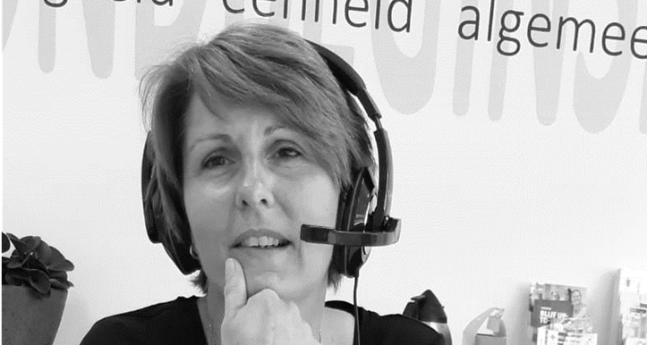
NICE TO MEET YOU!
Experience training Red Cross volunteers
Full Covid lockdown:
Online training volunteers BCO
Online first aid lessons
Notes:
2

Slide 3
COMMUNICATION
PUT YOURSELF ON MUTE TURN ON YOUR VIDEO ASK QUESTIONS

Slide 4
SAFE LEARNING ENVIRONMENT
Notes:
4

Slide 5
BODY LANGUAGE
RADIATE THAT YOU LIKE TO DO THIS (EVEN IF IT’S NOT)
Make eye contact with a look in de camera
Fill the screen, from your chest to head
Ensure a positive facial expression
Does not sit still, but move occasionally
Use gestures but not too much.
Notes:
5

Slide 6
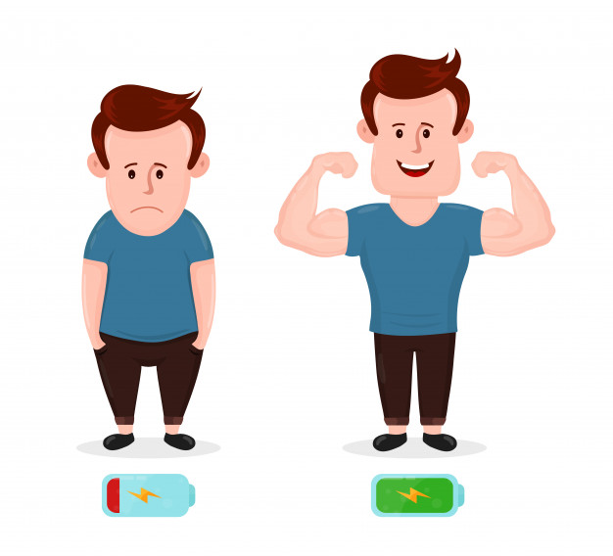
ENERGIZER
Drawn an emoticon
Mirror an image
Drawn it
Do 10 jumping jacks.
Notes:
6

Slide 7
CO-TRAIN = 2 TRAINERS IN 1 TRAIN
Do not consult each other in the Teams session.
(possibly whatsapp)
Don’t improve each other where the participants are at
Discuss roles
Discuss in advance what you like in the collaboration
Agree on who can take a break and when.
Notes:
7

Slide 8
WORKING METHODS
Quiz
Q&A: Who has a question?
Role-playing games
Digital skills training
Notes:
8

Slide 9
First Aid teaching online
Notes:
9

Slide 12
Good luck and thank you for your efforts!

