Slide 1
IFRC Europe RO
& GFARC
Priorities in First Aid

Slide 2
Let’s start by testing your knowledge
GO TO
https://app.klaxoon.com/join/MJAUBB8

Slide 3
First Aid is an integral part of Health and Care activities in EUROPE
Health in Emergencies
To create effective response mechanisms to reduce death and negative effects to the health of people in disasters and situations of crisis;
Universal health coverage with a focus on community health
-Advocating for access to health of the most vulnerable groups
-Acceleration of HIV prevention and reduction of the impact of HIV, AIDS and Tuberculosis, with special focus on non - stigma, non -discrimination
-Strengthened routine immunization and polio eradication programs.
-Strengthened blood safety programs through community mobilization, information sharing and documentation of best practices
Promotion of healthy life styles and NCDs prevention through the life-course
To support of the most vulnerable older people and promotion of healthy ageing.
To enhance Home care, social inclusion activities
Strengthening and advocate First Aid and Psychosocial support activities

Slide 4
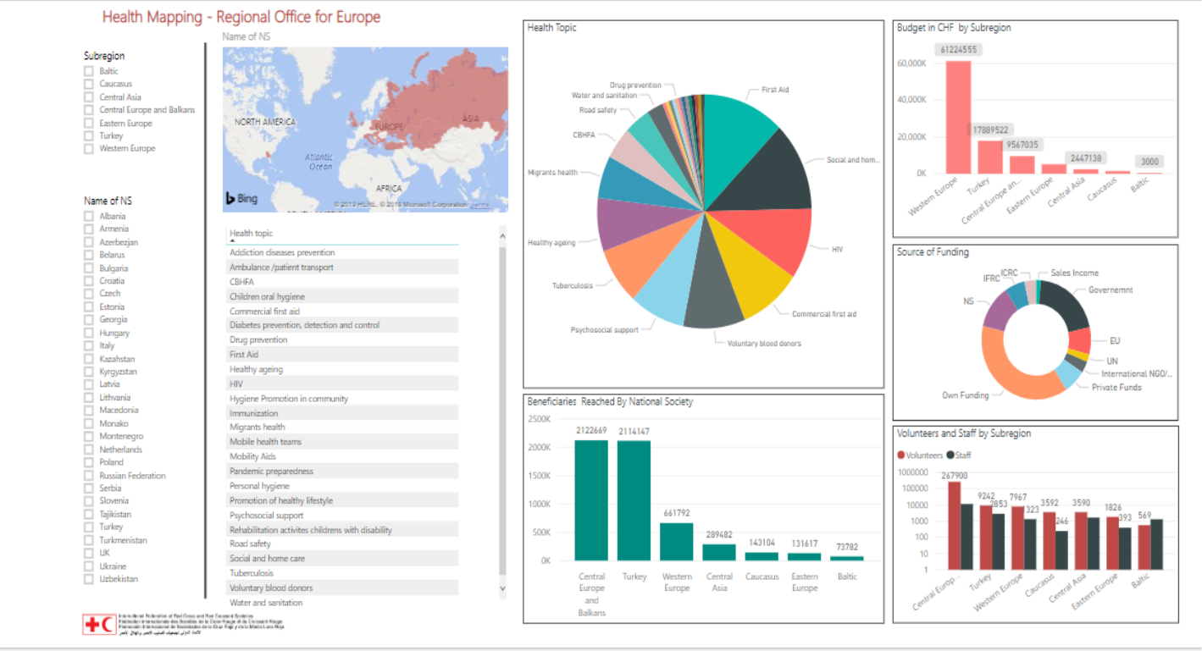
Data mapping Health and Care activities
29 National Societies
Data on Health activities
Data on beneficiaries
Data on number of staff and volunteers involved in implementation of different types of FA activities
Budget and source of founding

Slide 5
IFRC ROE Health and Care priorities –FIRST AID
To build capacity of the NSs of the region in FA programmes (FA for drivers, commercial FA, FA for older people, FA for children etc)
Integration to CBHFA
Special focus on FA component in Health in Emergencies (in particular in the COVID-19 context)
To increase presence in situations of mid and large- scale disasters, expand number of DREFs and Emergency Appeals with significant Health FA components.

Slide 6
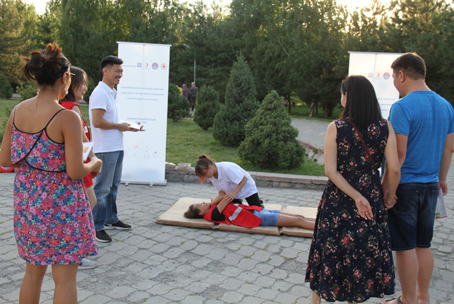
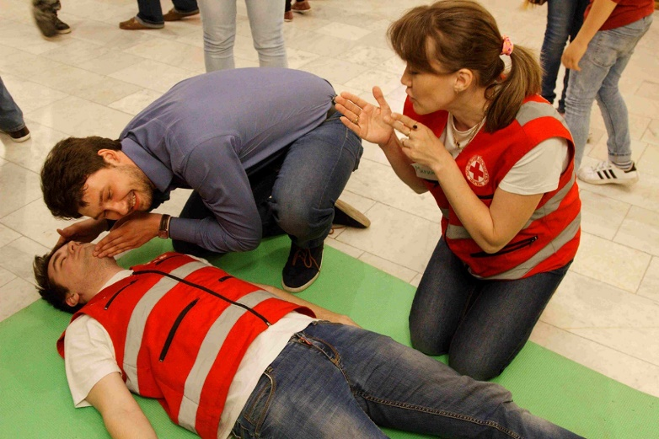
IFRC and GFARC cooperation in the NSs capacity building
To organize international trainings of Trainers of Trainers (ToT) for the National Societies which include the latest education methods of the Guidelines on First Aid and Resuscitation. In 2019, 12 NSs were trained in the international ToT curriculum.
To develop and adapt technical tools for the international ToT curriculum: five methodological tools were developed, disseminated and used by NSs in daily practice.
Facilitation of the International First Aid Attestation field test process among NSs
Joint organization of webinars: First Aid and COVID-19 facilitated by GFARC
Engagement of the NSs to the process of implementation of the new IFRC First Aid Guidelines (planned in 2021)
To attract funds for FA activities (for ex in link with COVID 19)

Slide 7
TOP 3 PRIORITIES
01
#Science #Education #Contextualization
03
Guidelines
IFAA
02
Platform
#Harmonization #PilotTest #Recognition #Quality #Assessement
#MarketPlace #SharingKnowledge #Ressources

Slide 8
COVID 19: MANY REQUESTS CAME FROM NS.
Series of webinars into English, French, Spanish and Arabic (more than 300 participants)
WFAD in link with the crisis
Ppt for NS to be used for informing their trainers about the good practices for trainings
A 20-page guide for first aid trainings during pandemic time
An on-line course
FOCUS on COVID 19.

Slide 9
Commercial first aid.
Technical content
Focus on the accidentology the company has to deal with
Marketing aspect
Business plan, prices, duration, materials…adapted to the first aid context
Harmonized trainings
Companies who wish to train their staff in an harmonized way
WEBINAR on 23rd October 20

Slide 10
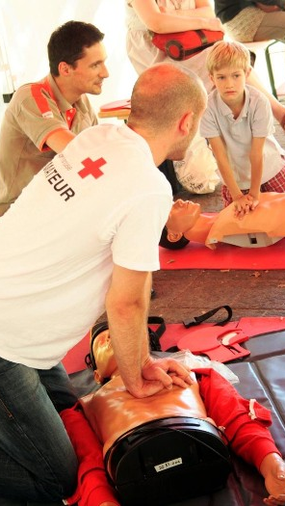
Facebook and Youtube channel
FACEBOOK. Community of practices More than 6700 followers and 1100 persons in the group.
Youtube channel launched on 1st July First aid in 4 languages, DRR, playlist, webinars, com’s campaign…

Slide 11
Question 1
According to you, what are the NSs’ needs as regards the first aid topic?

Slide 12
Question 2
How GFARC/IFRC ROE can better support you in fulfilling these needs?

Slide 13
Question 3
Do you have suggestions / ideas on how the communication and the support could be more effective, and how the NS between themselves can cooperate better and exchange the information and support each other?

Slide 14
Question 4
Among the priorities provided through Q1, which ones you would like to commit?

Slide 15
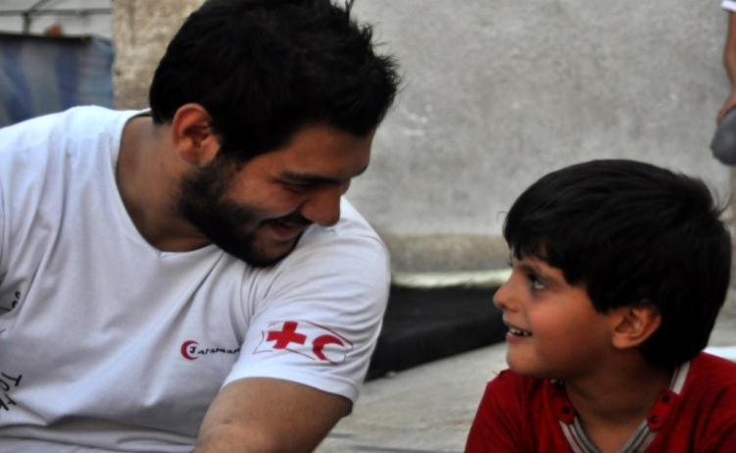
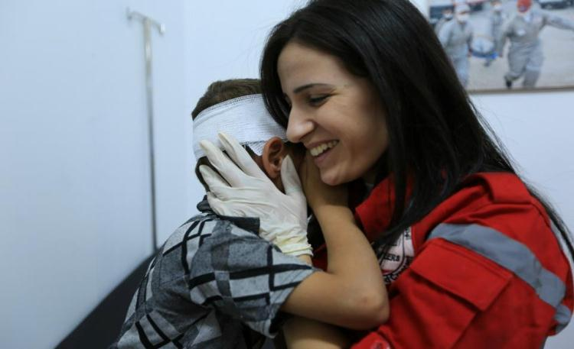
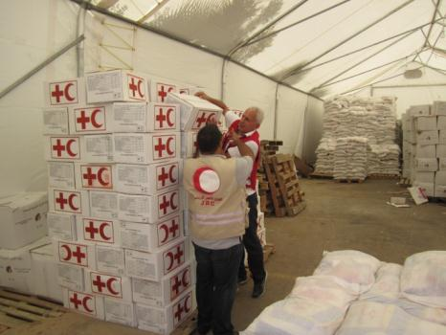
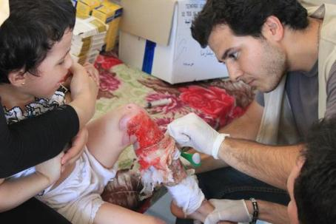
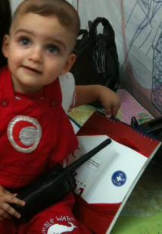
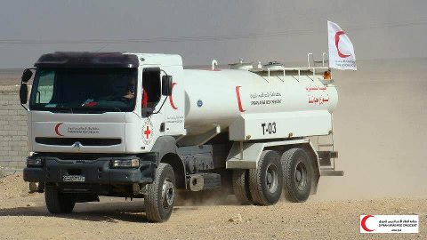
Thanks for your attention!

