Slide 1
Global First Aid Reference Centre
First Aid Education European Network
Stockholm
October 2019
Operated by

Slide 2
Global First Aid Reference Centre Main Objectives and Activities

Slide 3
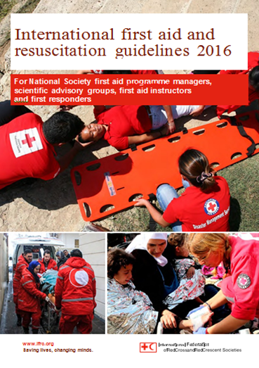
The 2020
Guidelines

Slide 4
Guidelines process 2020
OUR projects
New working groups
Interviews of the major contributors of the previous process
Survey of NS users
Digital tools will be added
A special focus on contextualization
Topics : Clinical, Education, Psychosocial, Aquatic, Crisis Situation, Disaster
A project
users centred

Slide 5
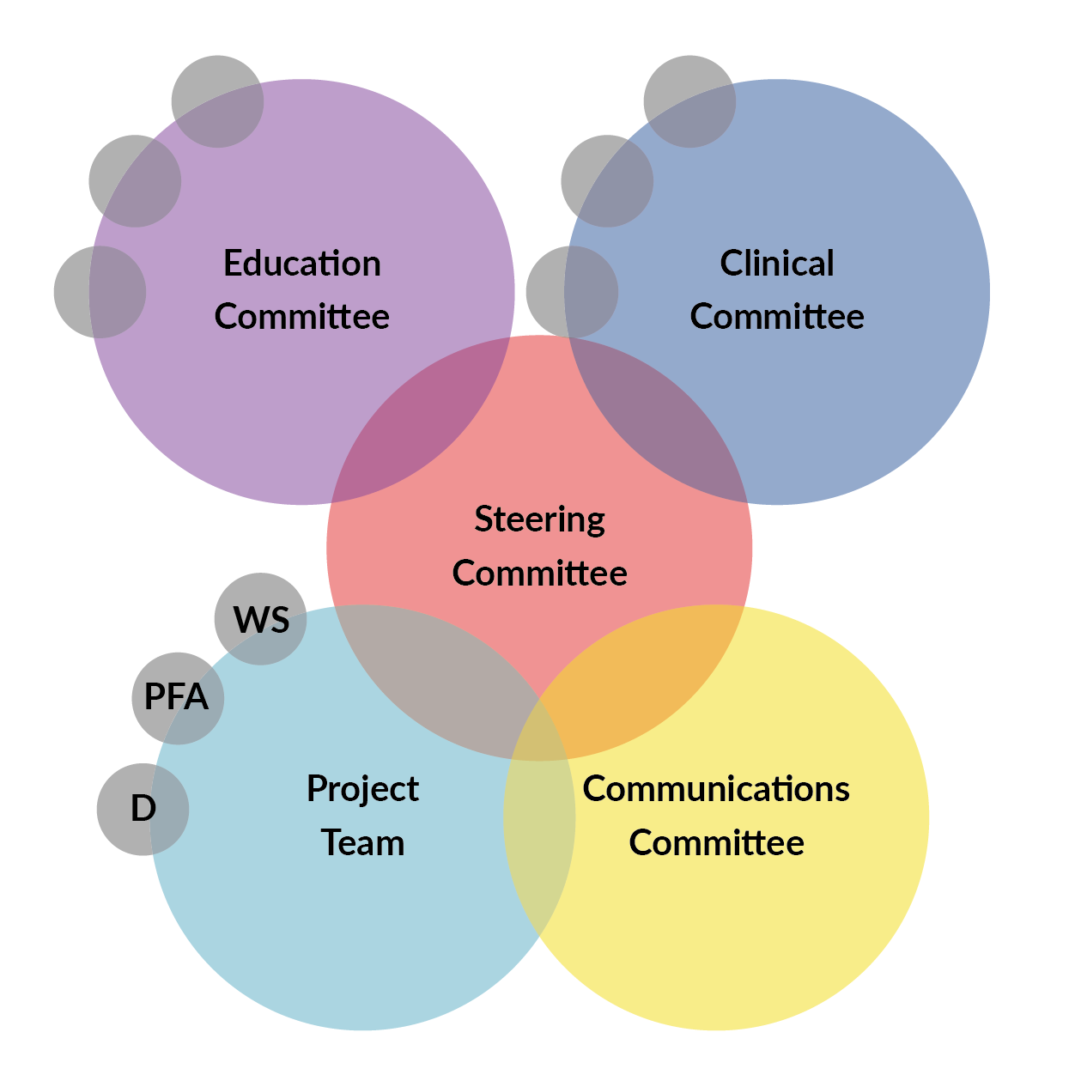
Teams

Slide 6
Schedule
Last Trim. 2020
Notes:
Transparency of process
Consistent outputs

Slide 7
IFAA
International First Aid Attestation

Slide 8
1) The International First Aid Attestation (IFAA)
IFAA
Background: a wish from National Societies
24-year experience of the European First Aid Certificate (EFAC): created in 1995
2012: 99% of the responding National Societies expressed their support to the creation of an international recognition (Ifop survey)
2018: 81% of responding NSs expressed their wish for the Federation to create an international first aid recognition award (GFARC 2018 first aid survey)

Slide 9
Definition
IFAA
The International First Aid Attestation (IFAA) is a recognition (as well as a continuous quality improvement process) that a first aid training provided by a RCRC NS is consistent with the latest IFRC International first aid and resuscitation guidelines, updated every five years.
The IFAA frame of reference is based on the IFRC International first aid and resuscitation guidelines as well as additional recommendations which will be jointly agreed on by National Societies and IFRC representatives during the IFAA pilot project.
The IFAA methodology relies on harmonisation rather than standardisation.

Slide 10
IFAA process and award stages
IFAA
The IFAA process and award stages are based on the EFAC.

Slide 11
2) IFAA pilot project
IFAA pilot project
The purpose of the IFAA pilot project is to define, together with Red Cross Red Crescent National Societies, the content, the process and the feasibility of IFAA.
This project includes the following activities:
Contributions of experts in first aid education, quality approach – including legal aspects – and communication to shape the IFAA content and process. These contributions will enrich the IFAA frame of reference mainly based on good practices from the field;
Field tests of the IFAA process in 5 National Societies from the 5 IFRC regions;
The setup of an IFAA representatives working group;
Consultations of National Societies and Federation representatives.

Slide 12
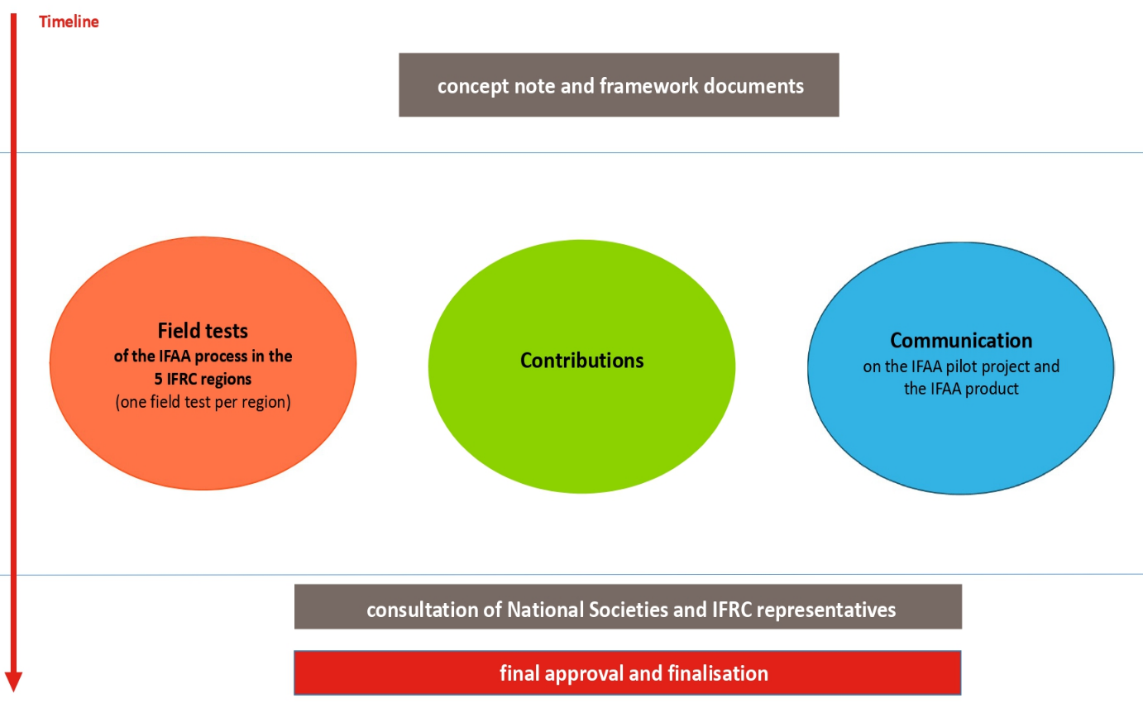
IFAA pilot project activities
IFAA pilot project

Slide 13
Voice of FAEEN
3) Survey on EFAC & IFAA
Survey on EFAC & IFAA
23 NSs responded to the survey (43% of Europe zone NSs):
20 NSs who have the EFAC or are in process to get the EFAC for one or some of their first aid course(s);
3 NSs who do not have the EFAC for one or some of their first aid course(s).
Preliminary results are presented below.
The survey remains open until 15 October.
Final results will be shared by email to all participating National Societies.

Slide 14
For NSs who have the EFAC or are in process to get the EFAC for one or some of their first aid course(s) (1/3)
Survey on EFAC & IFAA

Slide 15
For NSs who have the EFAC or are in process to get the EFAC for one or some of their first aid course(s) (2/3)
Survey on EFAC & IFAA

Slide 16
For NSs who have the EFAC or are in process to get the EFAC for one or some of their first aid course(s) (3/3)
Survey on EFAC & IFAA

Slide 17
For NSs who do not have the EFAC for one or some of their first aid course(s) (1/2)
Survey on EFAC & IFAA
Why has your National Society not already applied for the EFAC ?
3 different answers from the 3 different NSs:
The National Society does not think EFAC will bring a significant added-value to their first aid training program (1 answer)
Domestic regulations prevent the National Society from modifying your first aid course(s) to be awarded EFAC (1 answer)
The National Society is in the process of applying to IFAA (1 answer)

Slide 18
For NSs who do not have the EFAC for one or some of their first aid course(s) (2/2)
Survey on EFAC & IFAA

Slide 19
Questions from National Societies on IFAA
Survey on EFAC & IFAA
“IFAA recognition by governments”
“IFAA process and application”
“We still can not imagine anything specific about IFAA. A closer information for what is good and how it is used, would be great!” [colleague has been referred to IFAA factsheet]
“Could you already make a statement about the cost of certification?”
“Many questions but we only speak Russian”

Slide 20
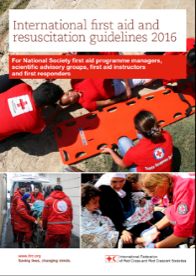
Research First Aid Education
Projects
Mapping and surveys
Creating a user guide
Define an outcome measurment
What is effective first aid education ?

Slide 21
Our collaborations
The objective is to develop a user guide to help first aid programers to include research in their projects and measure the outcomes. All of the results of these activities will be used in the International First Aid Guidelines.
With National Societies and RC entities
La Fondation and Andorran Red Cross are part of our experiment to measure learners outcomes and finance the project
British Red Cross is leading a global project on the outcomes measurement and testing performance of trainers
CeBaP is leading first aid evidence reviews and analyses paper which will be used for our global first aid programs
We are active member of the Scientific Council of American Red Cross

Slide 22
OUR PROJECTS
GFARC Training of trainers of trainers implementation
3 Red Cross Society of China ToT, March 2019
Regional ToT in Asia-Pacific, Kuala-Lumpur July/August 2019
Regional ToT for Russian Speaking countries Dec 2019

Slide 23
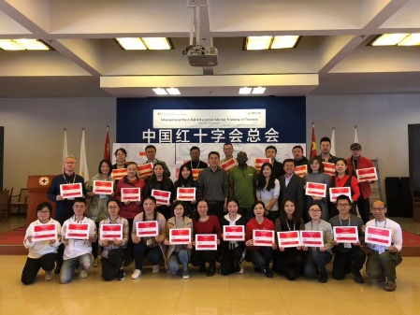
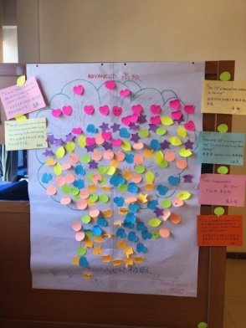
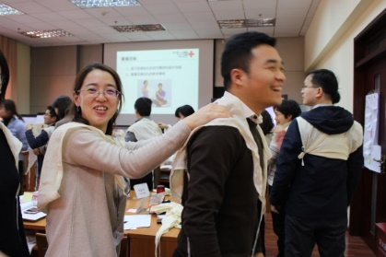
Implementing the Tot
Trainers curriculum to come
3 Trainers of Trainers RCSC
As part of its continued work to support National Societies in the development and delivery of meaningful and effective first aid education, the GFARC will expand the Trainer of Trainers project to develop a curriculum for first aid trainers relevant for all regions.
Supported by the Canadian Red Cross

Slide 24
World First Aid Day
Operational Support
2019 – First Aid and excluded people
14 September, 2019
Mime video pack
First aid assessment glossary
Vulnerable people resources pack
Climate and environmental first aid game (and its explanatory leaflet)
Inclusion tips one-pager
Picture frame (and its explanatory leaflet)
Infographics on key facts and figures
Short animations
Instagram story
Social media tips
2018 – Road Safety
A great success and good experiences
Tools : poster, test, slogan “You do not need a license to save lives.”
More than 50 reports collected

Slide 25
World Restart a Heart Day
16 Oct 2019 – First Collaboration with ERC and ILCOR and all Resuscitation Councils
Ex. 2 big events : Niger & Burkina Fasso
Operational Support
CPR EDUCATION

Slide 26
Collaborative platform
Support from BRC for the guidelines part
Sharing our ideas and resources
Platform available for all First Aid Programmers
Main contents
Tools produced by GFARC
Materials provided by NS
Discussion and forum
First aid Agenda

Slide 27
Simple mapping
Operational Support
HOMEPAGE
PURPOSE OF THE PLATFORM
Help and contact section
FA RESSOURCES
COLLABORATIVE
SPACE FOR WORKING GROUP
FIRST AID
AGENDA
NS CONTACTS
MAP IN 6 LANGAGUES
PROJECTS/TRAINING
PEDAGOCIAL TOOLS..
SUBMIT YOUR EVENT
FA GUIDELINES SPACE AT YOUR DISPOSAL

Slide 28
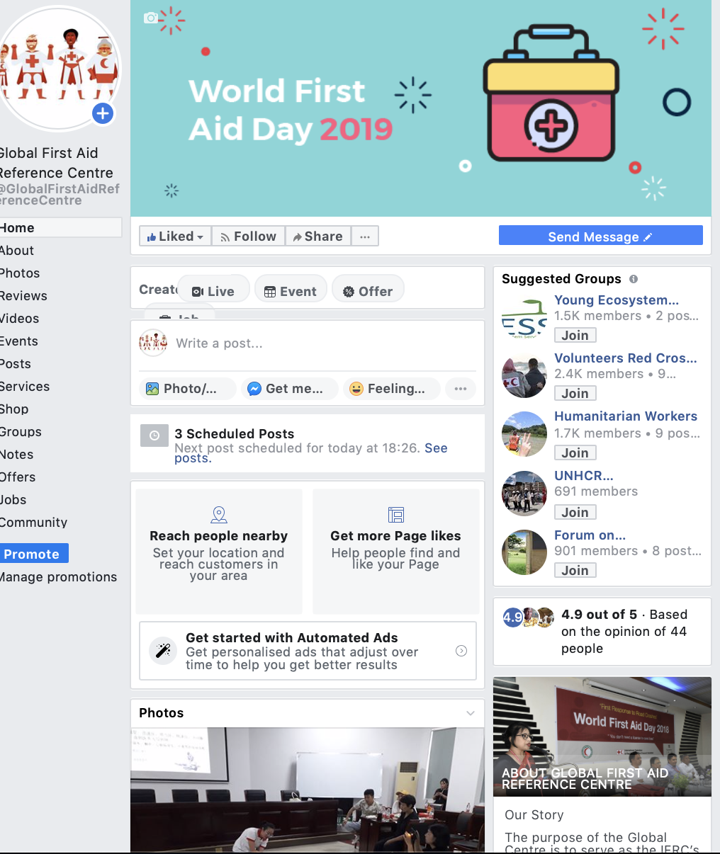
Web presence
5 700
Facebook
@Global First Aid Reference Centre
What about a like ? ☺

Slide 29
GFARC website 4th Trim. 2019 Guidelines website https://www.firstaideducation.net/ Online
Web presence
Websites

Slide 30
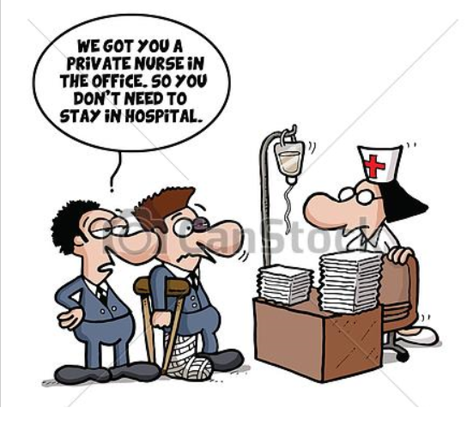
Commercial first aid
Projects
NS see CFA just as an income generation but shouldn’t it be a way to increase the number of first aid providers
Two aspects:
Technical content : Distance-worker from Rwanda identified to create FA techniques related to accidentology
Marketing : EU volunteer project II to focus on CFA aspect for African NS (pending on final answer)

Slide 31
Partners
Training in different National Societies according the demand of the partners with the coordination of GFARC

Slide 32
https://nam01.safelinks.protection.outlook.com/?url=https%3A%2F%2Fpress.airbnb.com%2Fred-cross-provides-safety-training-for-hosts%2F&data=02%7C01%7COmar.Abou-Samra%40redcross.org%7C100467bbf5f3488bb67c08d7108e53e0%7Cdd5b5d42c0d34ad2b5f160edb3af2771%7C0%7C0%7C636996075809164752&sdata=6Je4%2Fv%2B1e7g2EyTacNYEj5l4jfHInuTtFxVKEr5Rxpo%3D&reserved=0

Slide 33
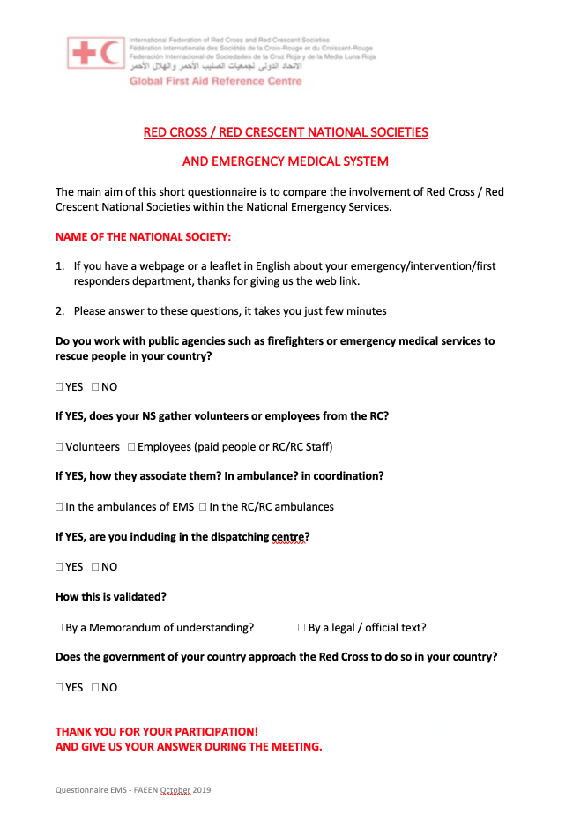
THANK YOU FOR YOUR HOME WORK!
EMS questionnaire
WFAD REPORT
WRAHD REPORT

Slide 34
Just an example of learner centred pedagogy

Slide 35
Thank you
© International Federation of Red Cross and Red Crescent Societies, Geneva, 2019.
Any information : first.aid@ifrc.org
Any part of this presentation may be cited, copied, translated into other languages or adapted to meet local needs without prior permission from the International Federation of Red Cross and Red Crescent Societies, provided that the source is clearly stated. Requests for commercial reproduction should be directed to the IFRC Secretariat at secretariat@ifrc.org
All photos used in this presentation are copyright of the IFRC unless otherwise indicated.
This presentation was written and developed by GFARC and produced in October 2019.
This presentation and relevant resources are available on https://www.firstaideducation.net

