Slide 1
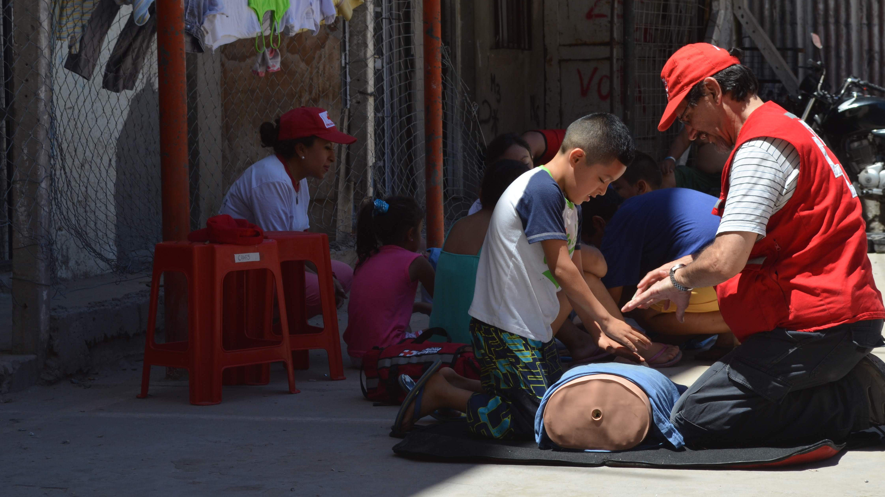
Global First Aid Reference Centre
First aid, resuscitation and education guidelines 2020
#firstaidforall
Notes:
Kris:
Welcome to the 2020 Guidelines FAEEN preview.

Slide 2
Notes:
Kris: This Evidence Based triangle will be familiar to many of you. It depicts the way we have developed the guidelines using science from published academic sources, the insight from experts, and the preferences of you, the users.

Slide 3
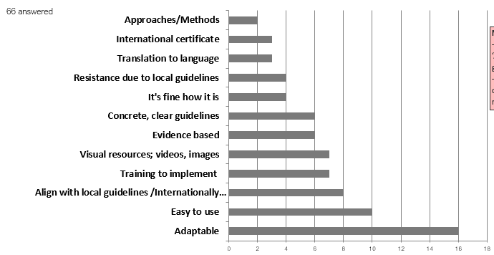
What would make your national society more likely to use the Guidelines?
Adaptable
Easy to use
Visual resources
Notes:
Kris
In 2018 we sent a survey to all National Societies asking for feedback on the 2016 Guidelines.
Your feedback has been the foundation of our approach to the 2020 Guidelines.
You can see from the graph that the most important things to change were to make the Guidelines adaptable and easy to use. We have responded by making sure that the content is readable and consistent across topics. The way the website is designed also means that the content is much more accessible, with more resources and tools for you to use.

Slide 4
Topic template
Topic title
Key action
Introduction
Guidelines
Good practice points
Chain of survival behaviours
Education considerations
Learner considerations
Facilitation tips
Scientific foundation
Systematic reviews
Non-systematic reviews
References
Systematic reviews
Non-systematic reviews
Prevent and prepare
Early recognition
First aid steps
Access help
Recover
Recommendations
Notes:
You also asked for the Guidelines to be consistent and functional so we developed a template that we have used for every topic.
Throughout the Guidelines, you will see the same layout and sections, starting with the key action, introduction, followed by the guidelines and good practice points, Chain of survival behaviours, educational considerations, scientific foundation, and references.

Slide 5
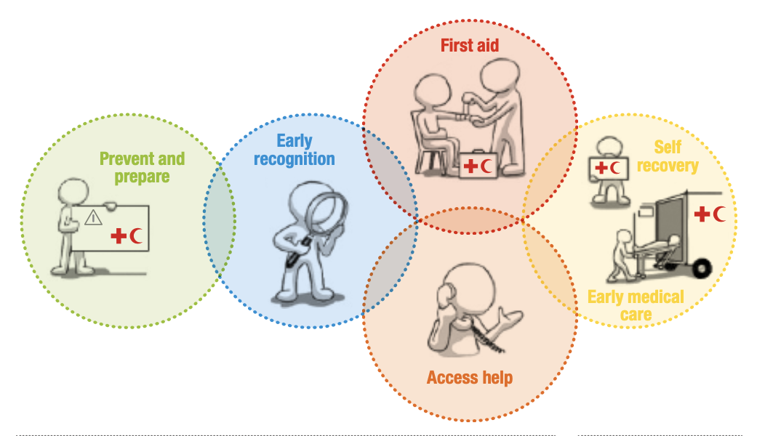
Chain of Survival Behaviours
Adapted from the unpublished Mammal Bites worksheet of the Guidelines.
Prevent and prepare
Avoid approaching stray or wild animals.
Be aware of specific diseases transmitted by animals in your area (rabies, anthrax, hantavirus, bovine, encephalopathy, etc.).
Early recognition
The person has visible teeth marks on their skin.
The person tells you they were bitten by an animal or human.
First aid
If the wound is bleeding, apply pressure to the wound to stop the bleeding. Follow the steps for Bleeding.
Notes:
To improve the functionality, we applied the Chain of survival behaviours to every topic.
Not only can you help people learn the first aid skill, you can include the important aspects of prevent and prepare, recognition, access help and recovery in your education as well.

Slide 6
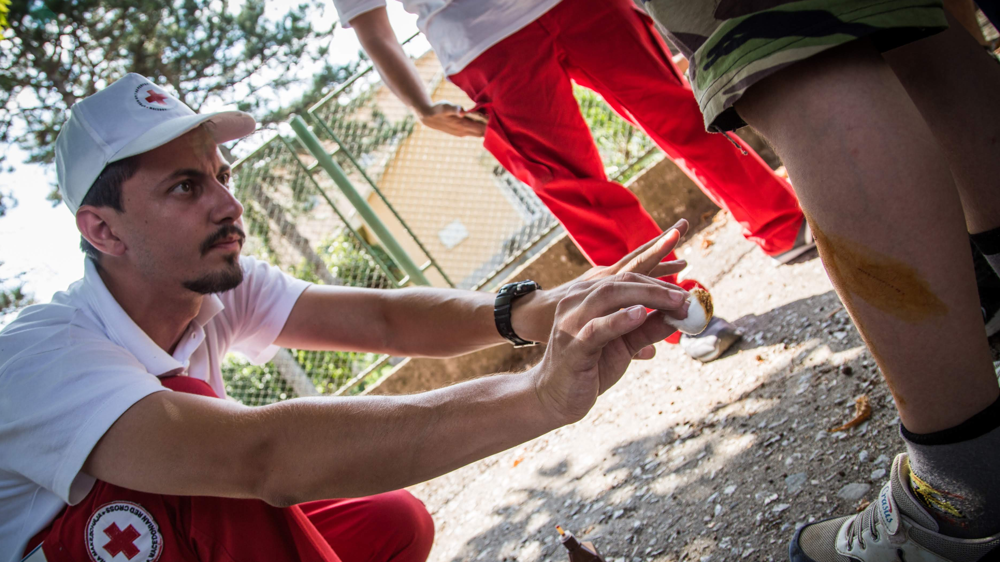
Links between topics
If the wound is bleeding, apply pressure to the wound to stop the bleeding. Follow the steps for Bleeding. Once the bleeding has stopped, complete the rest of the steps listed here.
Adapted from the unpublished Mammal Bites worksheet of the Guidelines.
Notes:
We also received feedback asking for better links between topics.
The beauty of having the Guidelines online means that we can easily link topics together. Here you can see how Bleeding is referenced within the topic on Mammal bites. If you click on the link, it will take you to Bleeding.

Slide 7
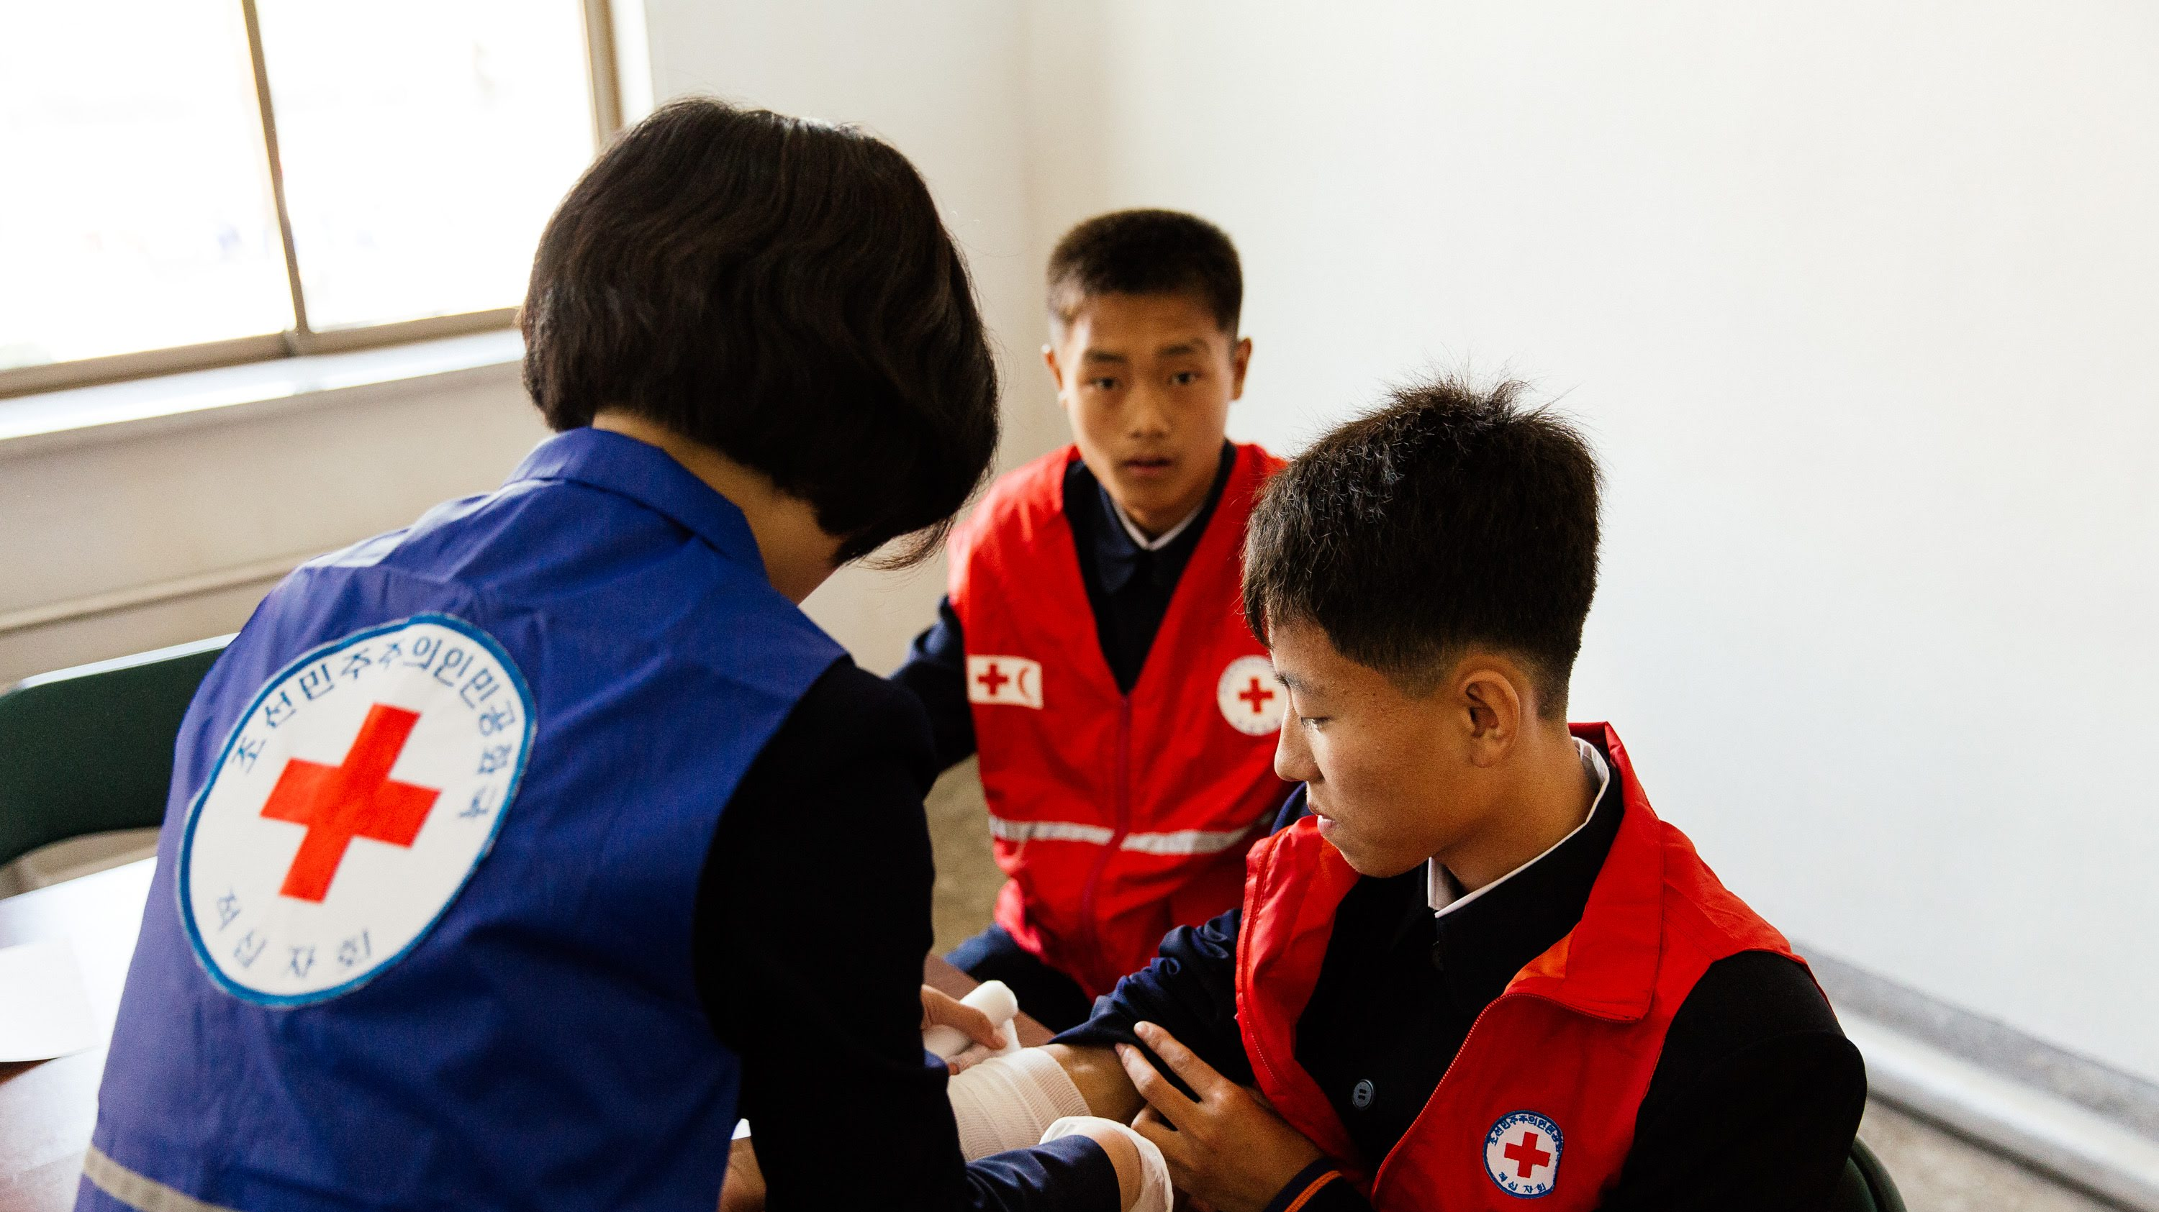
References
Lester, C., Donnelly, P., & Weston, C. (1997). Is peer tutoring beneficial in the context of school resuscitation training? Health Education Research, 12(3), 347–354. doi: 10.1093/her/12.3.347
UNAIDS (1999). Peer education and HIV/AIDS: Concepts, uses and challenges. https://www.unaids.org/sites/default/files/media_asset/jc291-peereduc_en_0.pdf
Wik, L., Brennan, R. T., & Braslow, A. (1995). A peer-training model for instruction of basic cardiac life support. Resuscitation, 29(2), 119–128. https://www.researchgate.net/profile/Robert_Brennan2/publication/15539020_A_peer-training_model_for_instruction_of_basic_cardiac_life_support/links/59e97b5fa6fdccfe7fec4575/A-peer-training-model-for-instruction-of-basic-cardiac-life-support.pdf
Adapted from the unpublished Peer Learning worksheet of the Guidelines.
Notes:
And we have made the references more accessible. Although not all the links are available, many of them are.

Slide 8
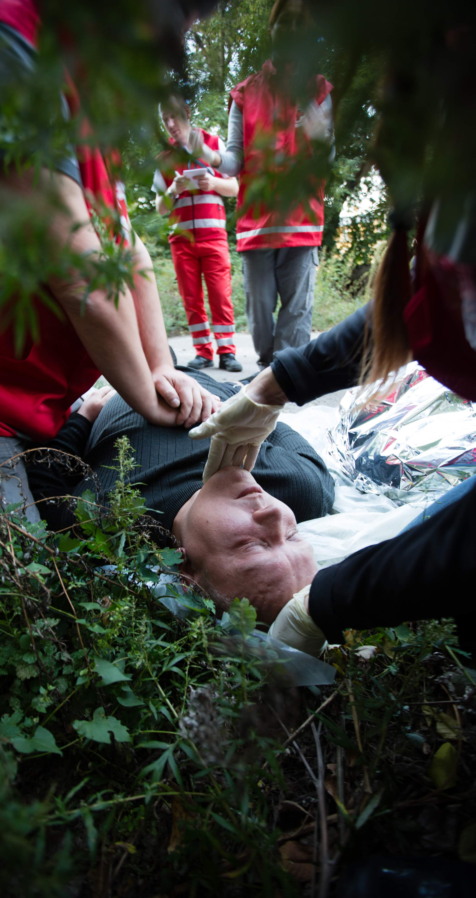
Section 2: First Aid
Notes:
Emily
We have expanded the first aid topics to include some new topics people asked for, such as Emergency childbirth and Narcotic overdose.

Slide 9
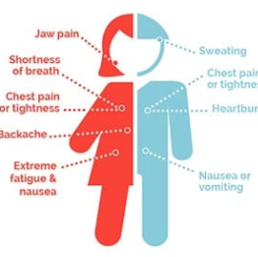
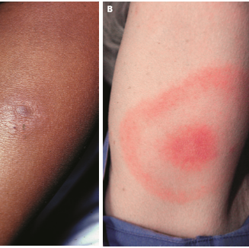
Notes:
Most importantly, we have listened to your request for the Guidelines to have greater relevance around the world. Although much of the scientific evidence comes from developed western contexts, we have reached out to colleagues from around the world to ensure that the Guidelines apply to a diverse range of resource settings and cultures.
The framework provided by the Chain of survival behaviours has helped to do this but some topics are still lacking, and we hope that you can help us to make the Guidelines even more relevant to the range of communities we serve.
For example, we know that some forms of disease and injury present differently on certain skin colours, age groups and genders. We need your help to address these gaps.

Slide 10
Section 3: Education
Notes:
Emily: The education section in 2016 focused on theory as well as some specific learning methods. Feedback told us we needed to expand this section—so we involved more experts!
I’ve been privileged to lead a group of 45 contributors from over 25 countries to collect and review the evidence on education.
We consulted many of you on the Education section and listened to the topics you wanted evidence on and what your educational priorities are for the next 5 years.

Slide 11
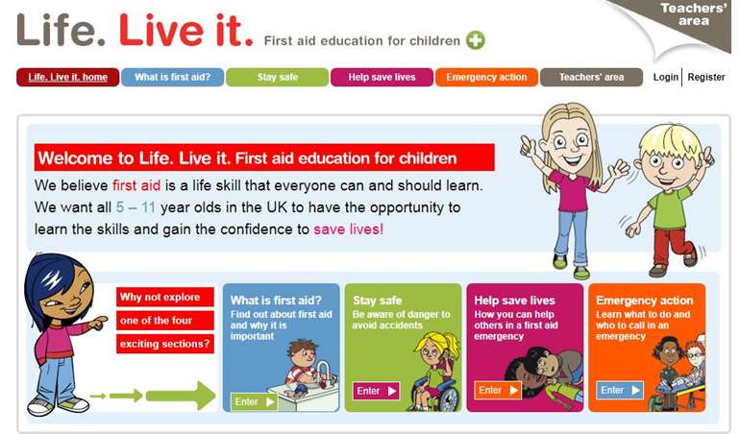
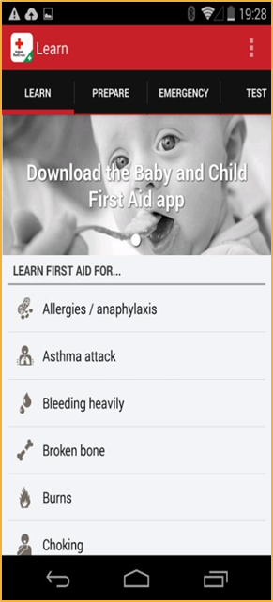
Learning Modalities
Blended learning
Peer to peer
Online learning
Video learning
Media
Refresh and retrain
Motivation to learn
Feedback devices
Gamification
First aid learning for children
Notes:
One of the main things you wanted to see was more evidence on different learning modalities: how effective is online learning; how much should we rely on phone apps, and what are the best ways to refresh and retrain our learners? So we have a significant new sections covering as many of these topics as we could.

Slide 12
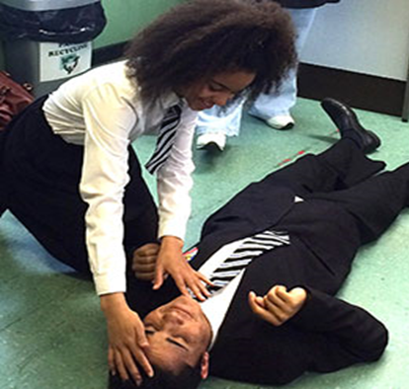
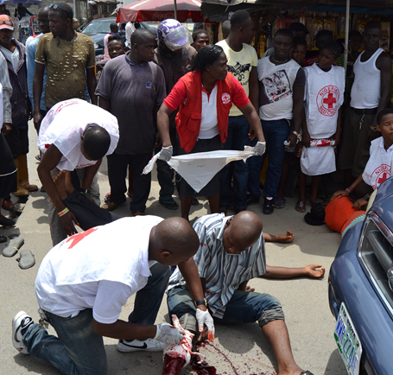
Beyond the Modalities
Every first aid topic includes an education section
Notes:
Education is also prominently included elsewhere in the Guidelines. Based on your feedback, we have included an education section in every single topic to provide insight on different contexts, types of learners, as well as facilitation tips and tools.
Some topics still need more of these insights and you will have the opportunity to input your ideas.

Slide 13
Section 4: Contexts and the Website
Notes:
In addition to making the Guidelines more adaptable to different learners, we also have looked at specific contexts where the Red Cross movement works. In particular we have considered contexts where educators might need to facilitate learning differently because of that context.

Slide 14
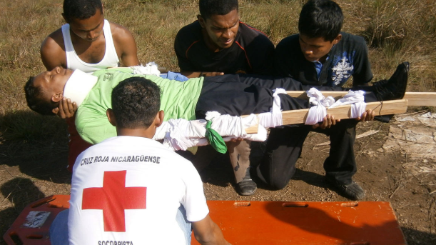
First aid contexts
Conflict
Disaster
Mass casualties
Remote places
Water
Workplace
Pandemic
Notes:
Emily: The Guidelines for our Movement are unique as they include insights from the variety of contexts in which we operate.
This year, we have developed evidence-based sections on learning first aid in areas of conflict, disaster, near water and in remote settings. We know these places are challenging and first aid education needs to adapt to best suit the people in these contexts.
As such, the focus might be on safety and security, rather than rescue. Or we might focus on transportation and extended care.
Two additional contexts we have included are first aid during a pandemic and in the workplace. Again, we focus on the different considerations for these contexts and how, as a National Society, you might deal with them.

Slide 15
The new GFARC website
Notes:
Adele In addition to the implementation meetings, we have been collecting feedback through the user experience testing of the new website that will host the Guidelines.
With that being said, welcome to the Global First Aid Reference Centre platform, home of the 2020 International First Aid Resuscitation and Education Guidelines! The project aims to deliver a responsive multi-functional platform to host the international guidelines and community-centred resources to support large scale preparedness and resilience.
The Reference Centre wants to increase usage and awareness of the Guidelines AND enable staff and volunteers to deliver First Aid Training consistently across the Red Cross Red Crescent movement.
We also wanted to create a community platform and engagement tool where users can share and learn about successful First Aid processes and teachings.
Resources section: Here we are building a repository of toolkits, videos, learning aids, lesson plans and other resources that educators can use to enhance their programmes. In the final meeting we will talk a more about these and how you can contribute.
First Aid Heroes: we have been collating our first aid hero stories and invite you to share your story.
Training Directory: View the contact details for each National Society’s training team. We are also looking to add social media icons so please send yours across.
Facebook: This is a community group. 3000+ people around the world, teaching and learning First Aid.
First Aid News: This is news and events from around the world.
Local adaptation page

Slide 16
Timeline
2020 International First Aid and Resuscitation Guidelines (IFARG)
01
07
03
05
Implementation
meetings
02
04
Dissemination & branding
Steering Committee approval
and final read
06
Translation and layout
Production
Make the changes from the Implementation Meeting
Posting to the Platform for Nov.
First sending in December for Office, contributors
Notes:
Kris

Slide 17
How did you implement the guidelines in your NS in 2016? What challenges did you face? What are your plans for the new guidelines?
Over to you:

Slide 18
Global First Aid Reference Centre
Thank you!
#firstaidforall
Notes:
Thank you for your attention. We look forward to working with you.

