Slide 1
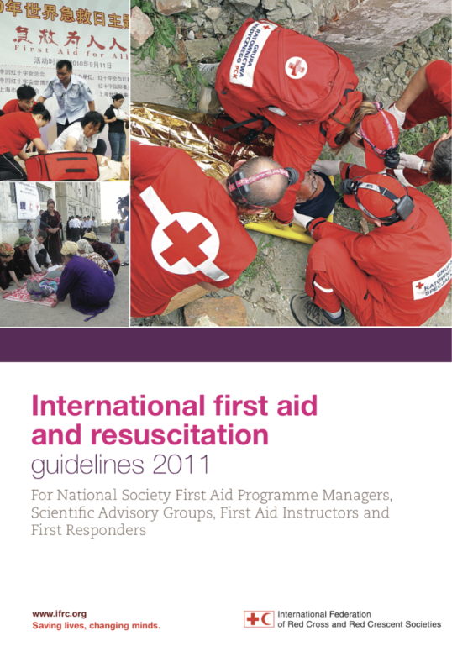
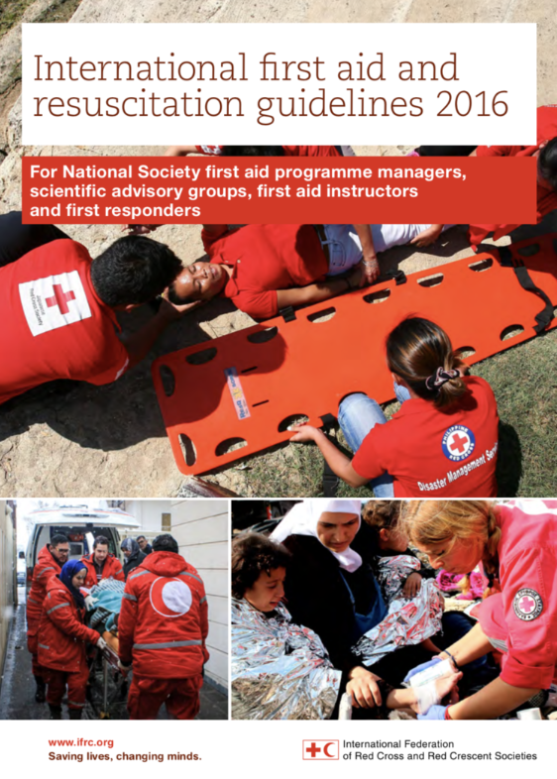
International First Aid, Resuscitation, and Education Guidelines 2020
International First Aid, Resuscitation, and Education Guidelines 2020

Slide 2
Key Partners

Slide 3
FAEEN 2018
Ability to adapt to a local context
Mapping to local protocols
Varied audiences require tools (refugees, deaf people, school children, aquatics, etc.)
Many resources required:
Videos
Apps
Evaluation tools

Slide 4
Topics of the Guidelines
Introduction
Local adaptations
Overall considerations in providing care
Education
Impact
Learning theories to support first aid behaviours
Measuring effectiveness
Adaptation based-on relevance and needs of learners
Motivation of the learner
Scenario and simulation learning
Online and blended learning
Refreshers
Clinical
General approach
Assessment
Call for help
De-escalation techniques
Medication administration
Medical
Injury
Environmental
Animal related impairments
Resuscitation
Drowning and aquatics
Psychological first aid
First aid
Video learning

Slide 5
Topic Structure
Evidence
Scientific Foundation Summary
Education considerations
Guidelines
First Aid Steps
Key Action
Teaching and Evaluation Tools

Slide 6
Topic Structure
Topic title
Introduction
Education considerations
Guidelines
First Aid Steps
Key Action
Concise title to describe the condition/injury.
Definition
Common contexts
Recognition
First aid steps
Additional treatment for contexts
The most important action to be taken to provide treatment
Expert opinion of the first aid steps for a low resource and a high resource setting.
Audience and Teaching methods
Scientific Foundation
Refresh and Efficiency
Summary of scientific evidence

Slide 7
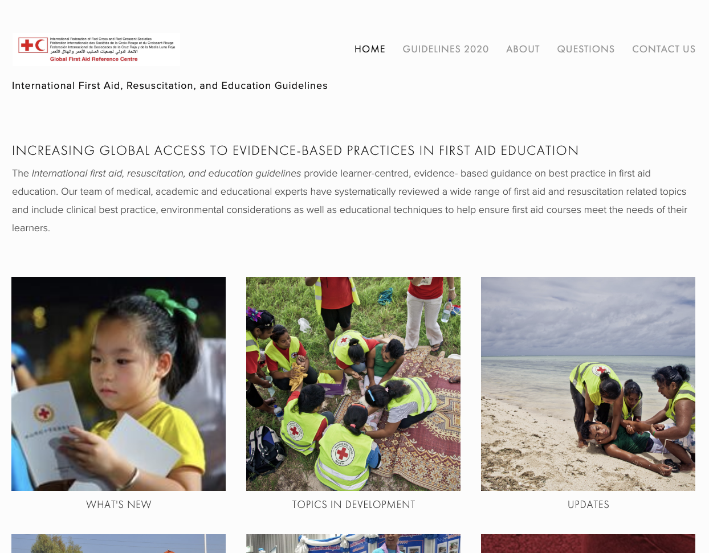
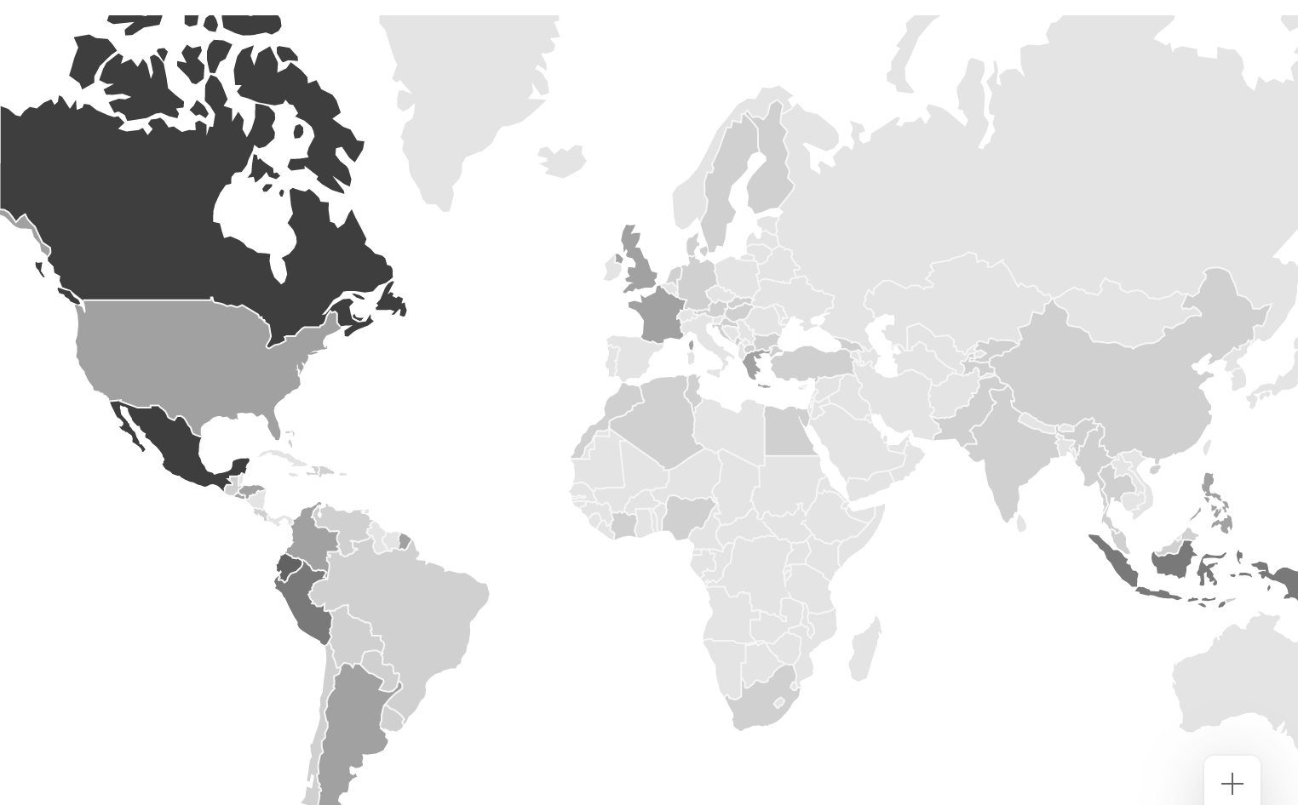
firstaideducation.net
Initial platform went live yesterday.
Over 200 visits in the first day from around the world.
Partnership with the Aviva Foundation secured through the British Red Cross to build a full platform.

Slide 8
Questions

Slide 9
International First Aid, Resuscitation, and Education Guidelines 2020

